Slide 1

An NSS Audio-Visual
Library Presentation
The Best of the
1990 NSS Photo Salon
National Speleological Society
S912 74 Slides 2/22/2021

Slide 2
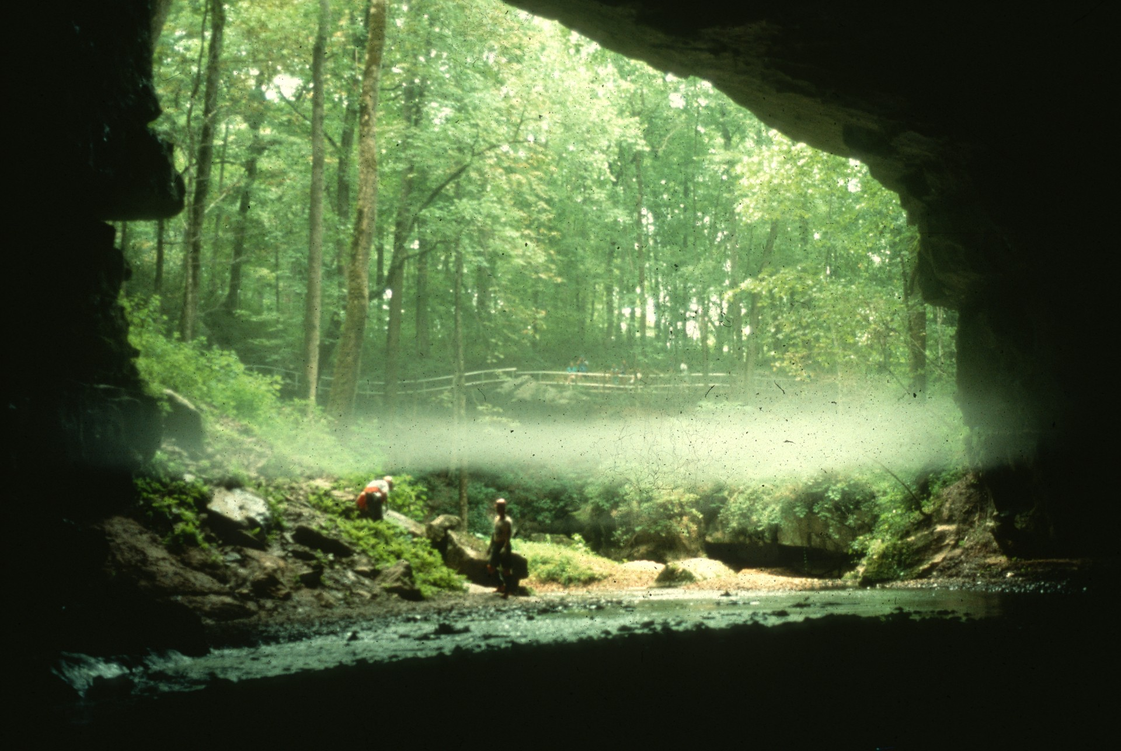
Notes:
A Tennessee Misty Morning – John Scheltens

Slide 3
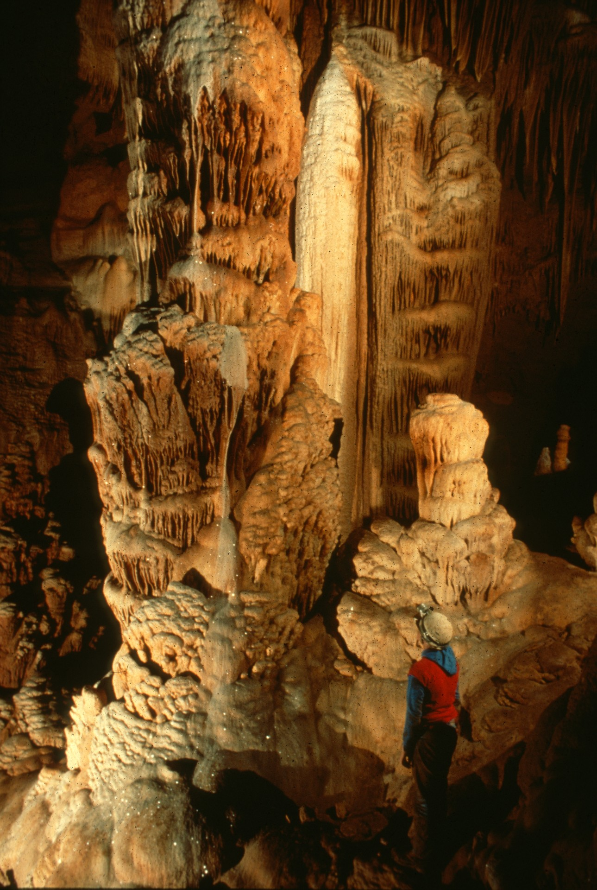
Notes:
Not Lechuguilla, Either! – Rick Day

Slide 4
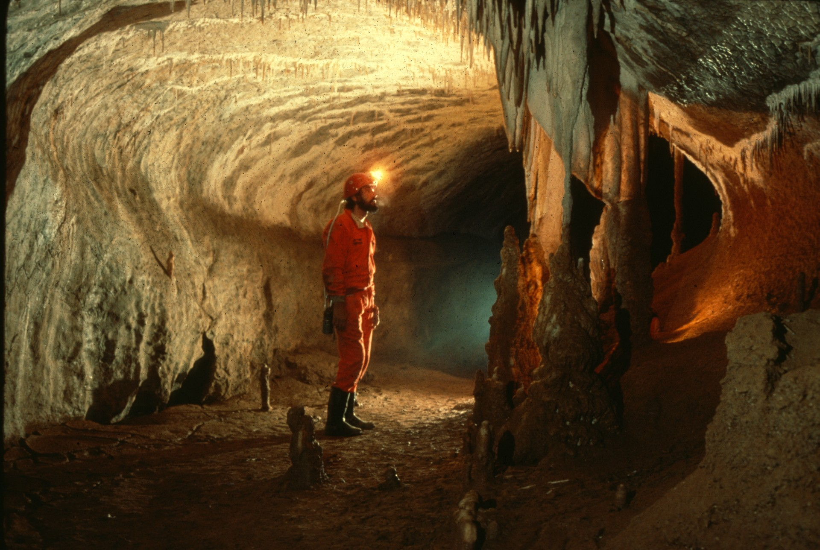
Notes:
Daniel and Draperies – Carolyn Cronk and Cristian Lascu

Slide 5
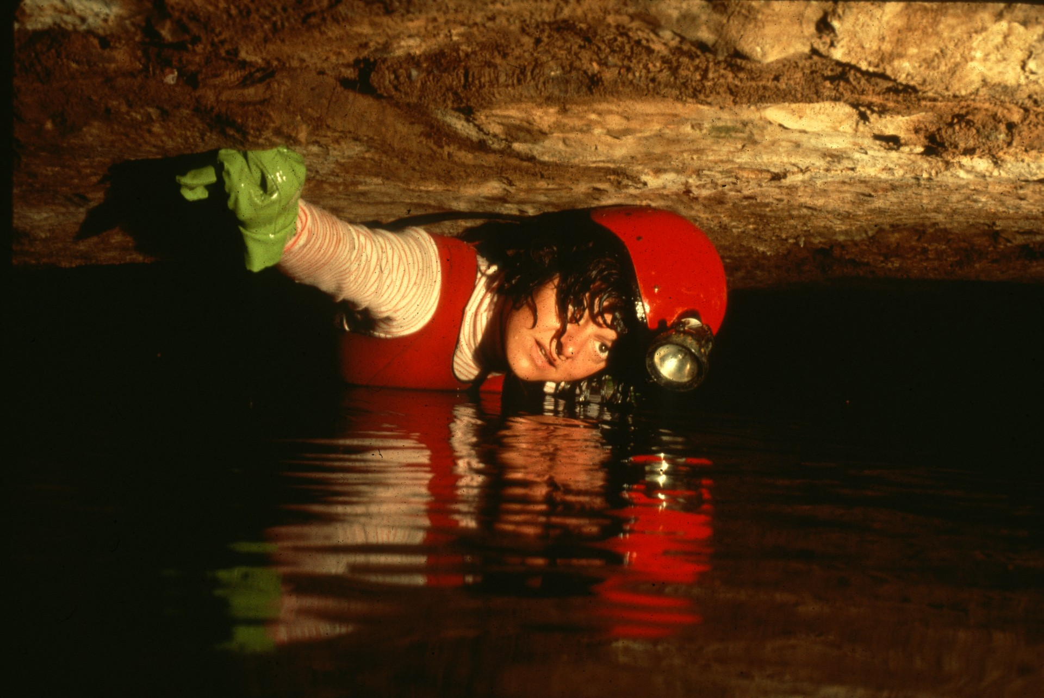
Notes:
Tina’s Tub – Scott Fee

Slide 6
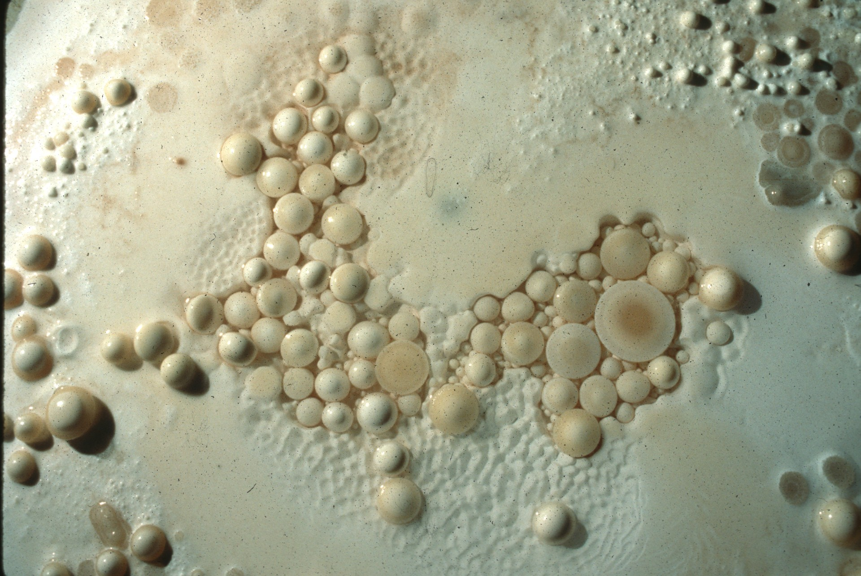
Notes:
Pearl Variations – Dave Bunnell

Slide 7
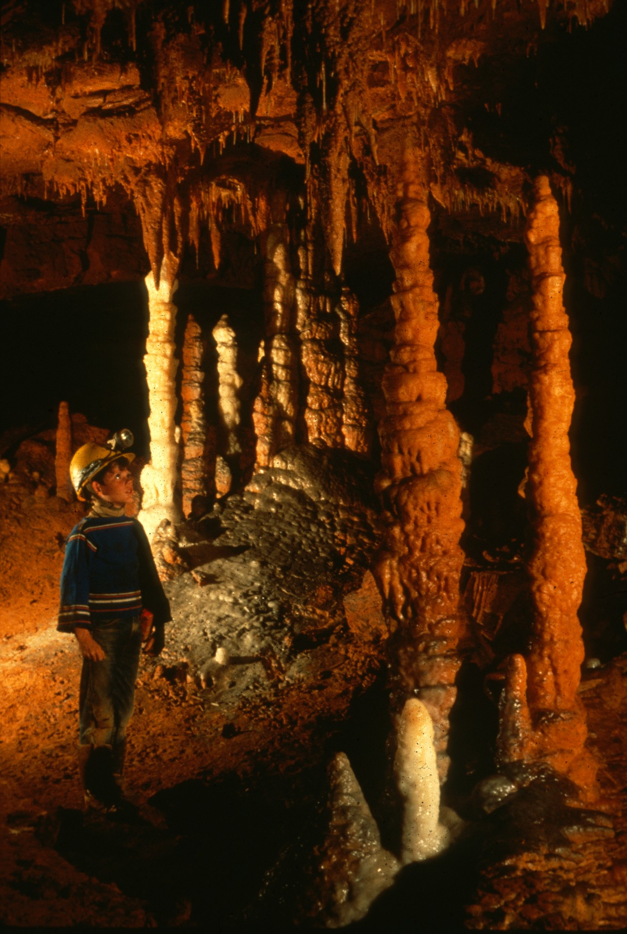
Notes:
A Colorful Childhood – Rick Day

Slide 8
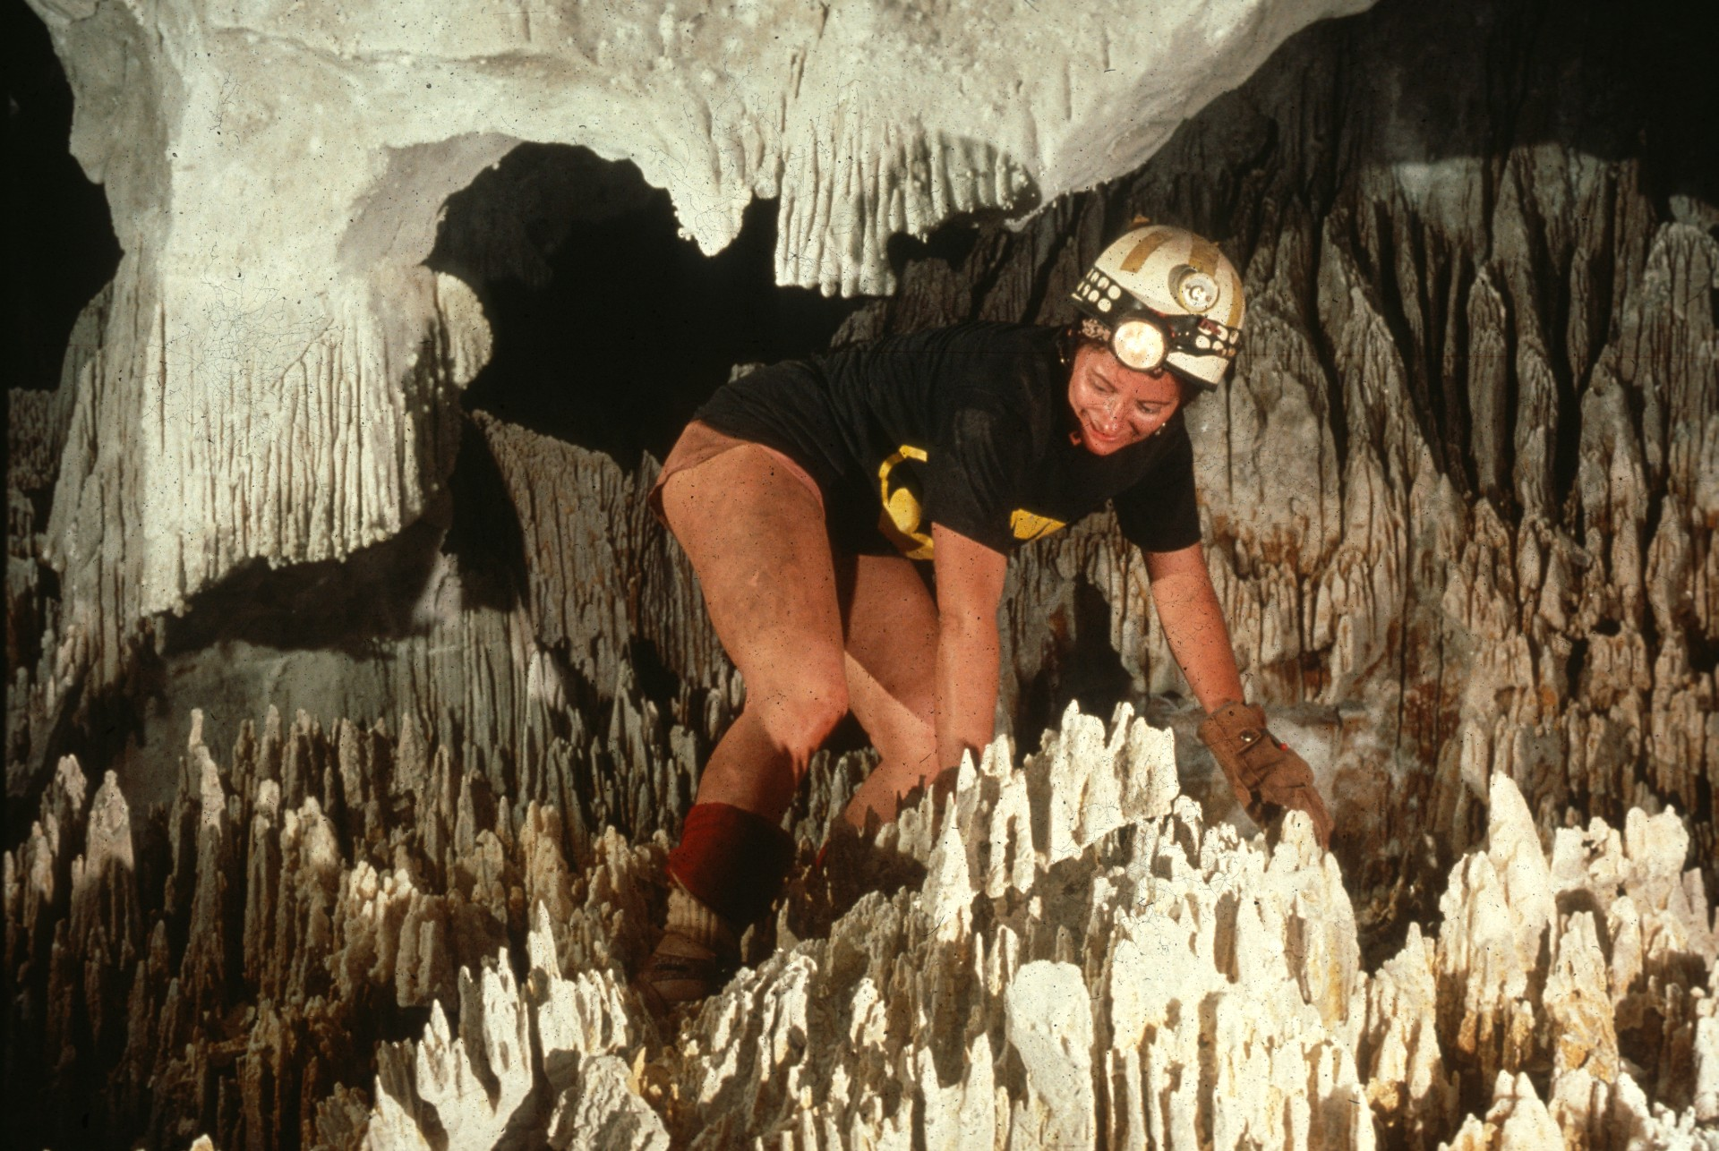
Notes:
Pat in “Bryce Canyon” – Peter and Ann Bosted

Slide 9
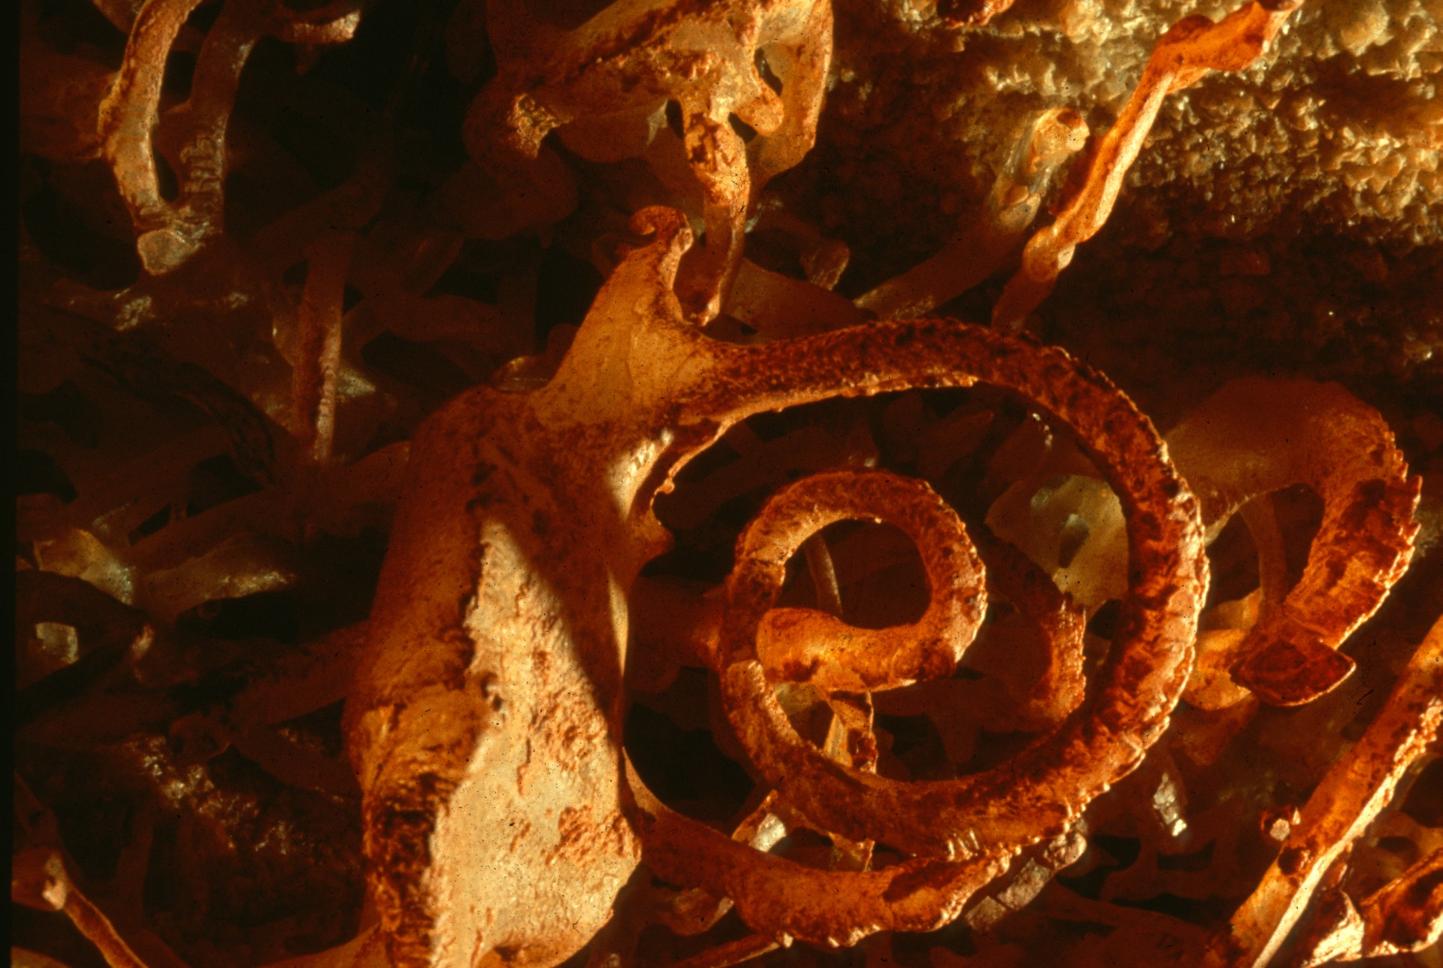
Notes:
Calcite Coil – Rick Day

Slide 10
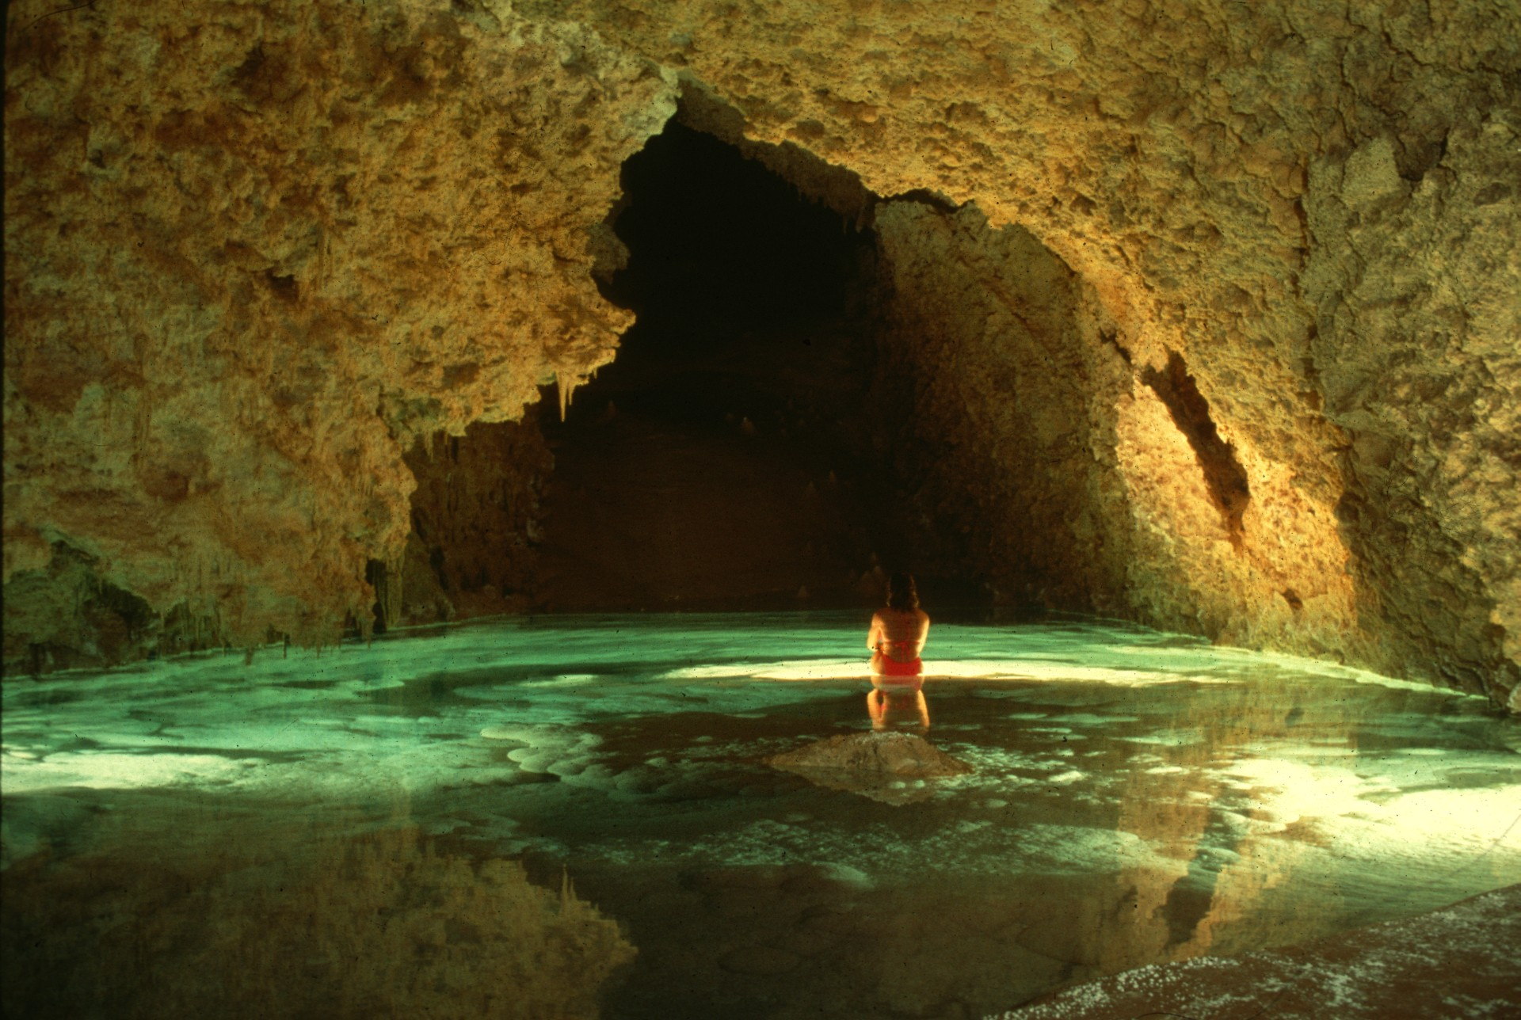
Notes:
Aqua Fantasia – Dave Bunnell

Slide 11
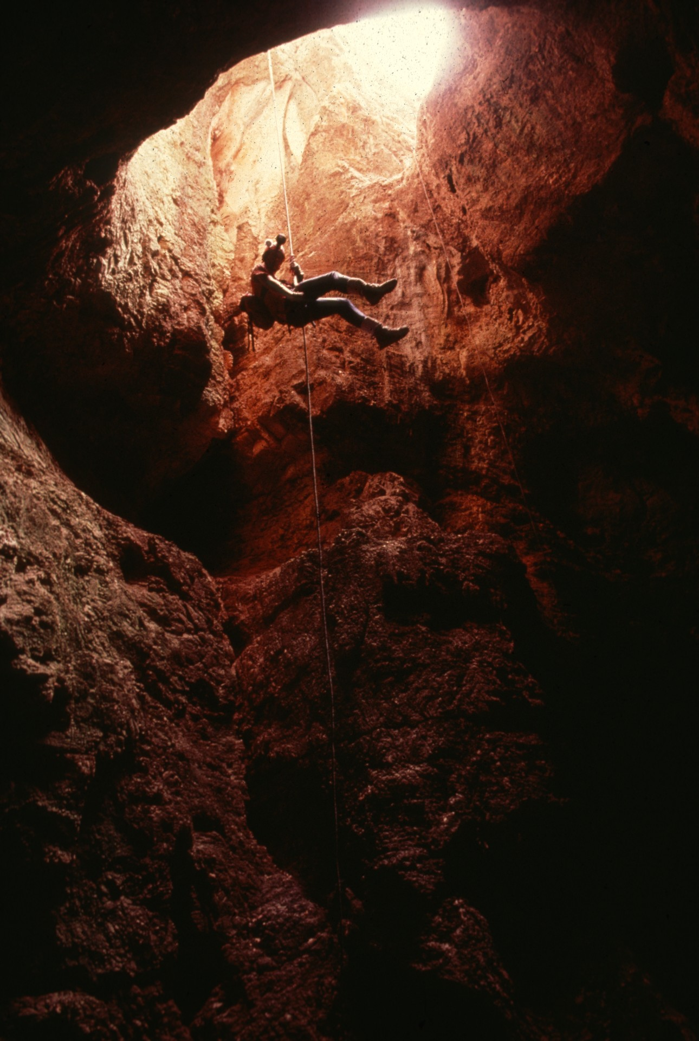
Notes:
One More Trip to Lechuguilla – Gregg Oelker

Slide 12
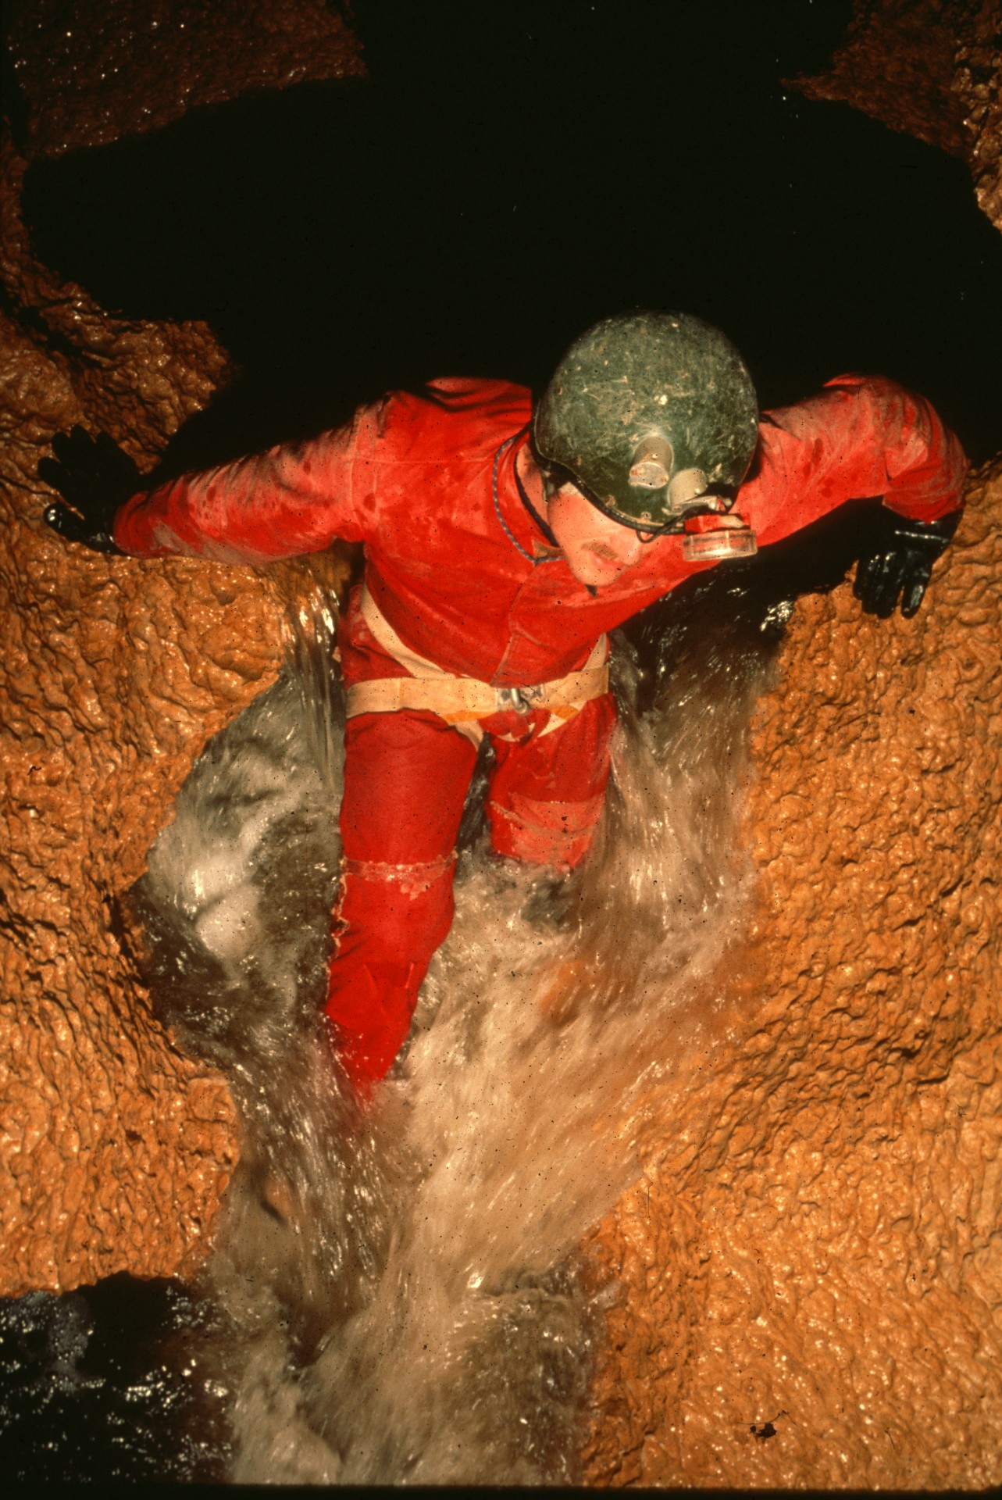
Notes:
Go With the Flow – Ron Simmons

Slide 13
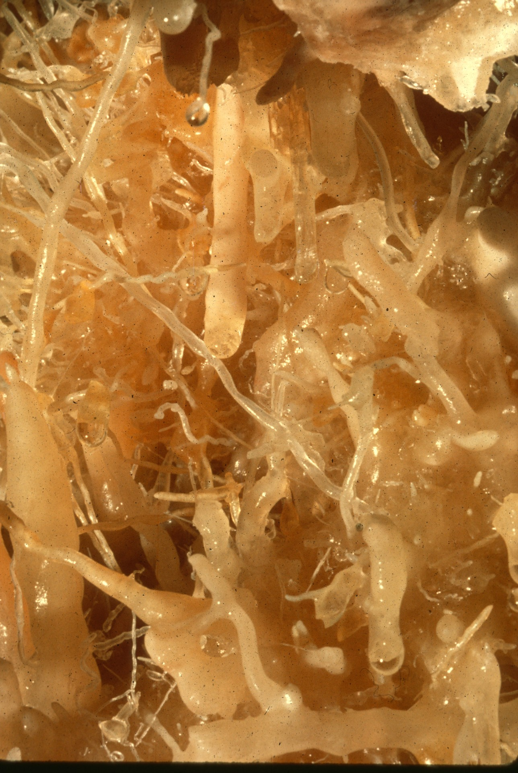
Notes:
Helicacies – Rick Day

Slide 14
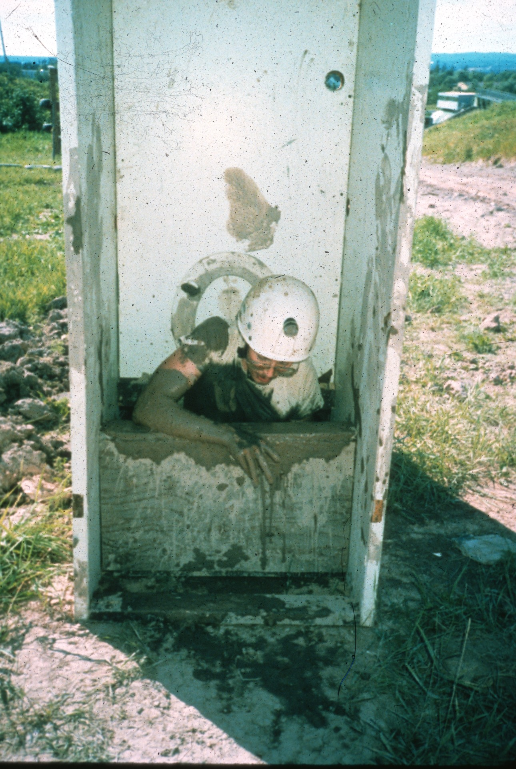
Notes:
The Sludge Climb – Horton H. Hobbs, III

Slide 15
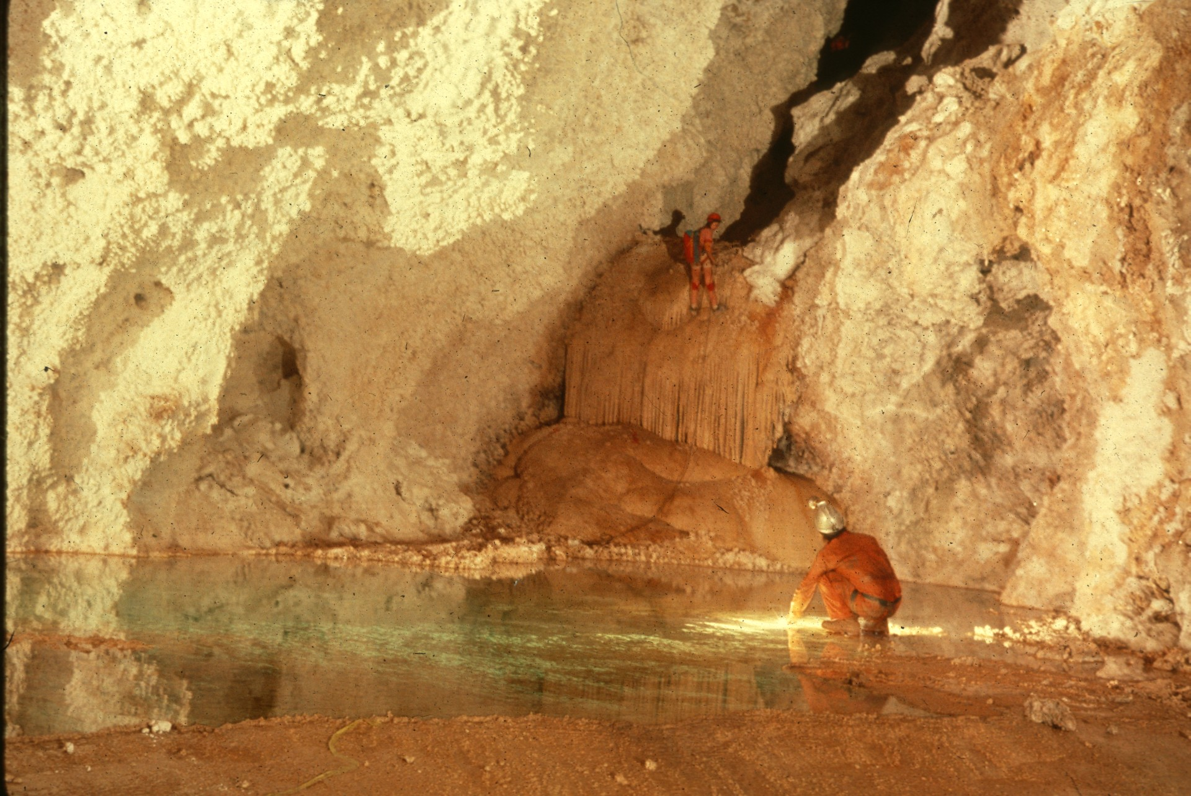
Notes:
Lake LaBarge – Peter and Ann Bosted

Slide 16
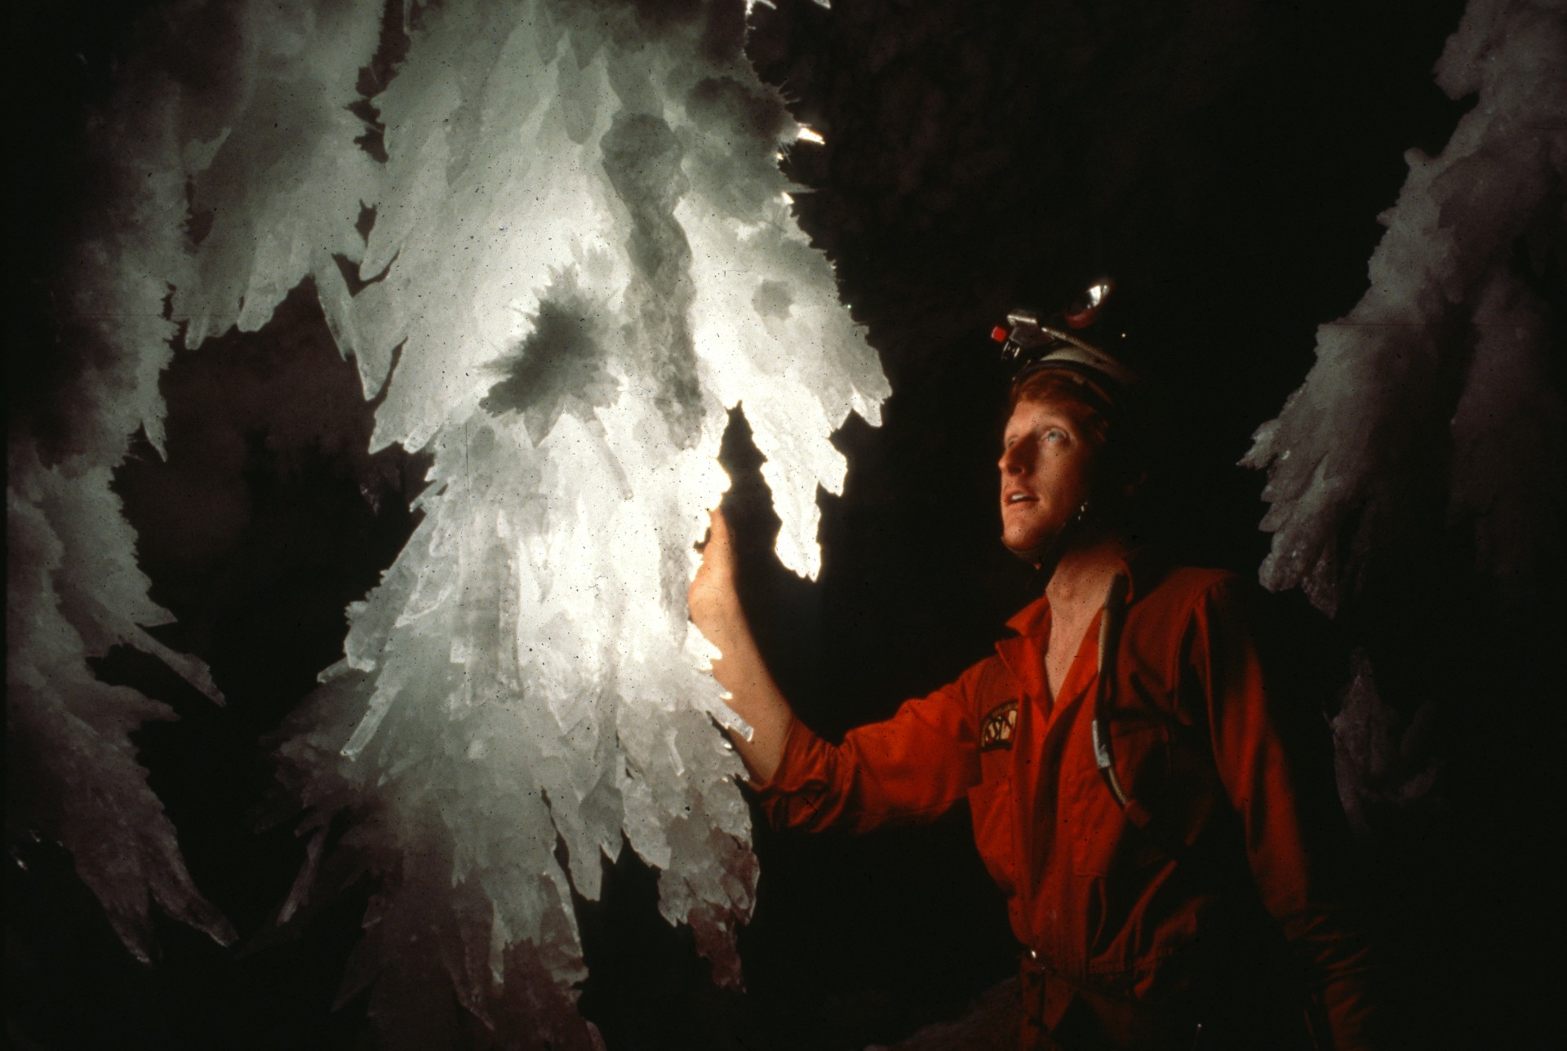
Notes:
Carl – Bill Storage

Slide 17
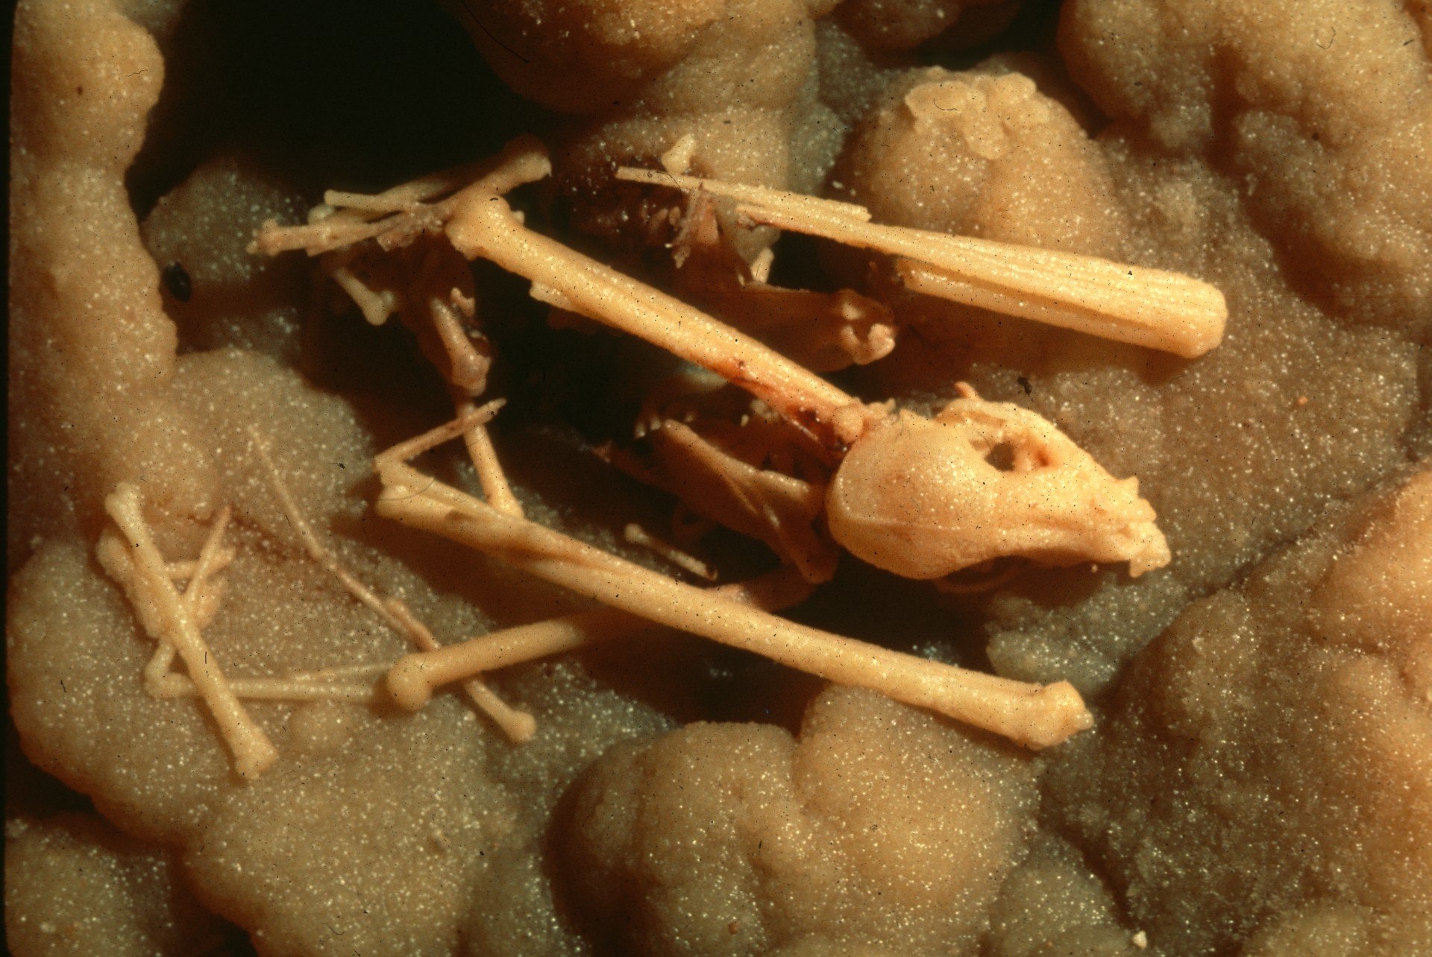
Notes:
But What a Place to Die! – Rick Da

Slide 18
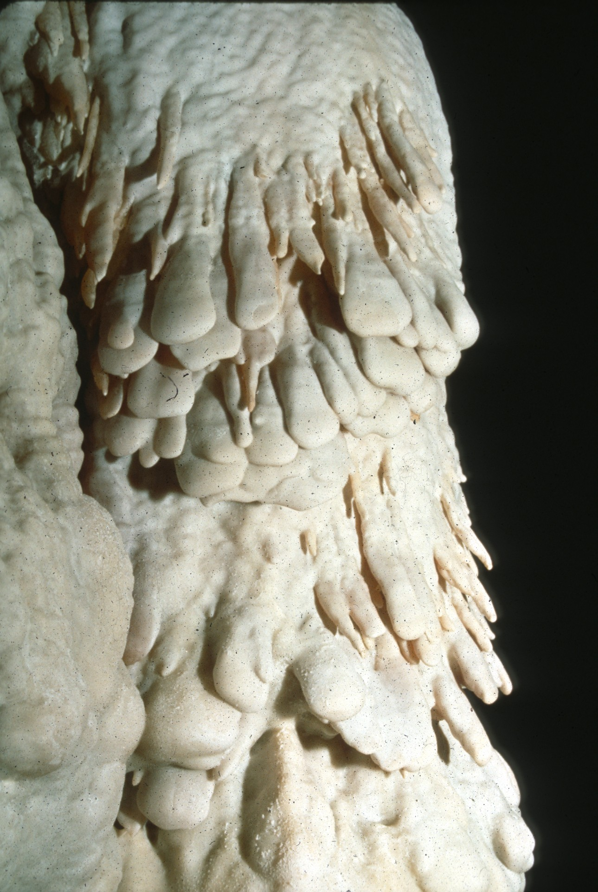
Notes:
Waffle Fingers – Dave Bunnell

Slide 19
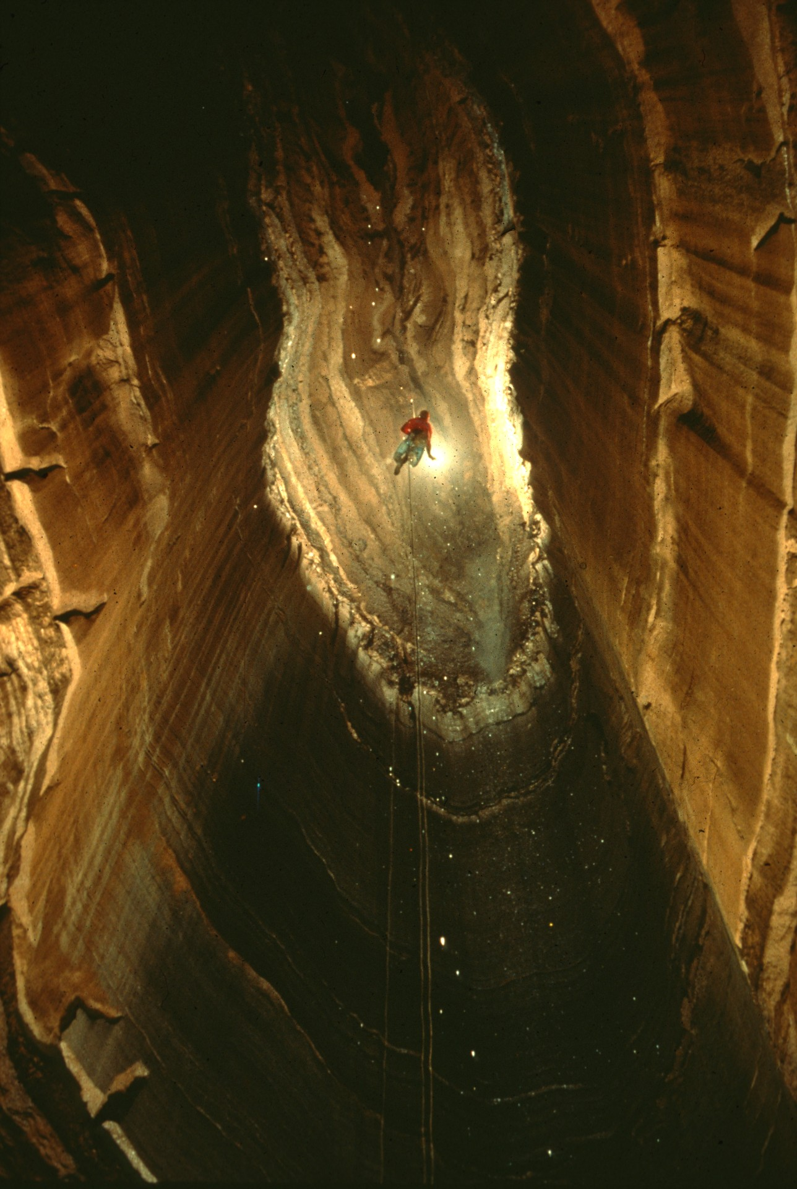
Notes:
Devil’s Dungeon – Jim Loftin

Slide 20
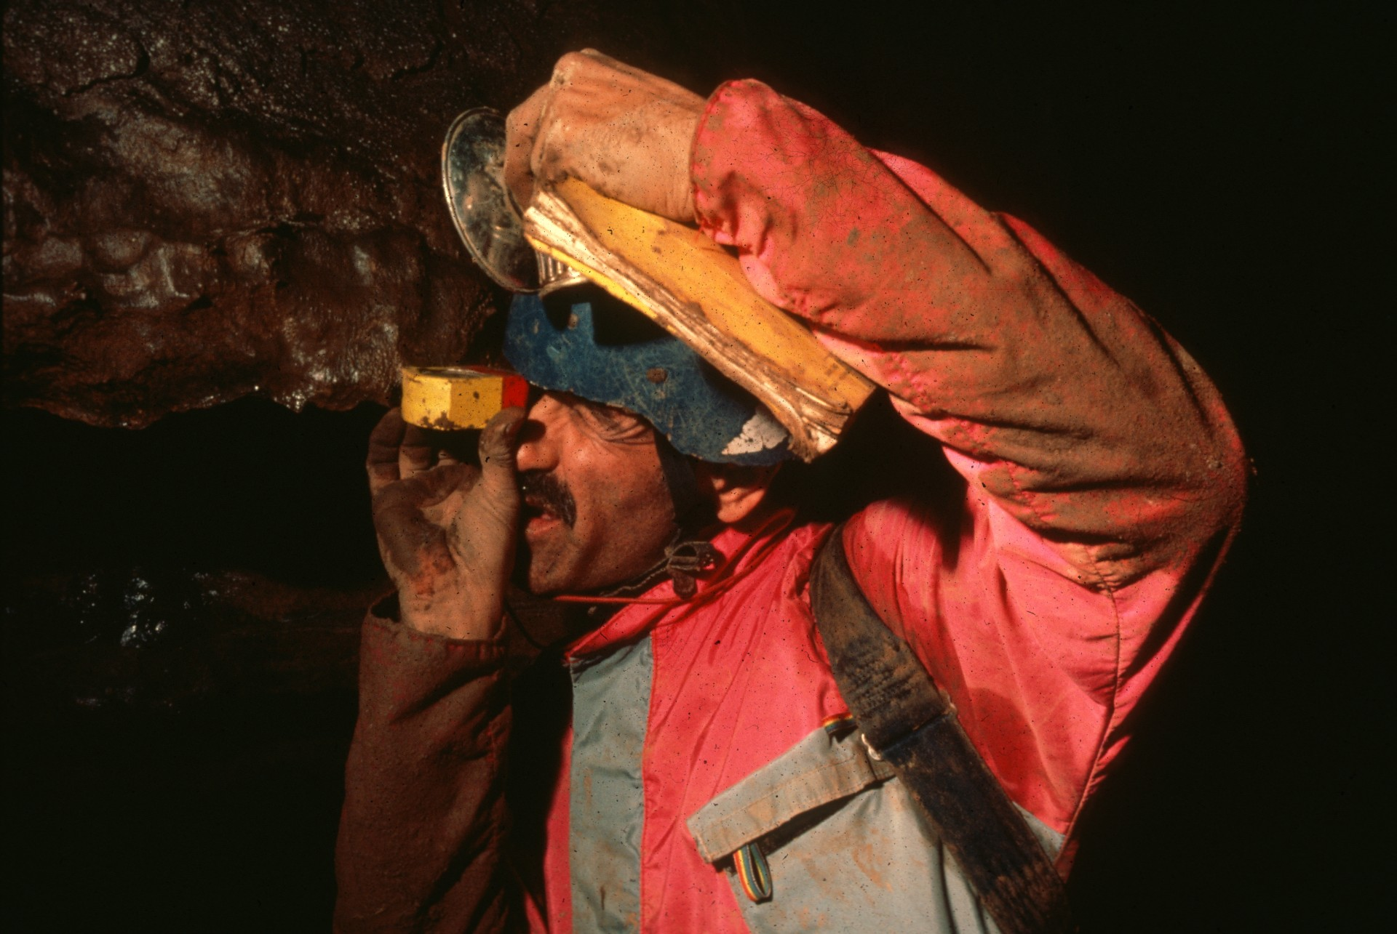
Notes:
Mr. Survey – Ron Simmons

Slide 21
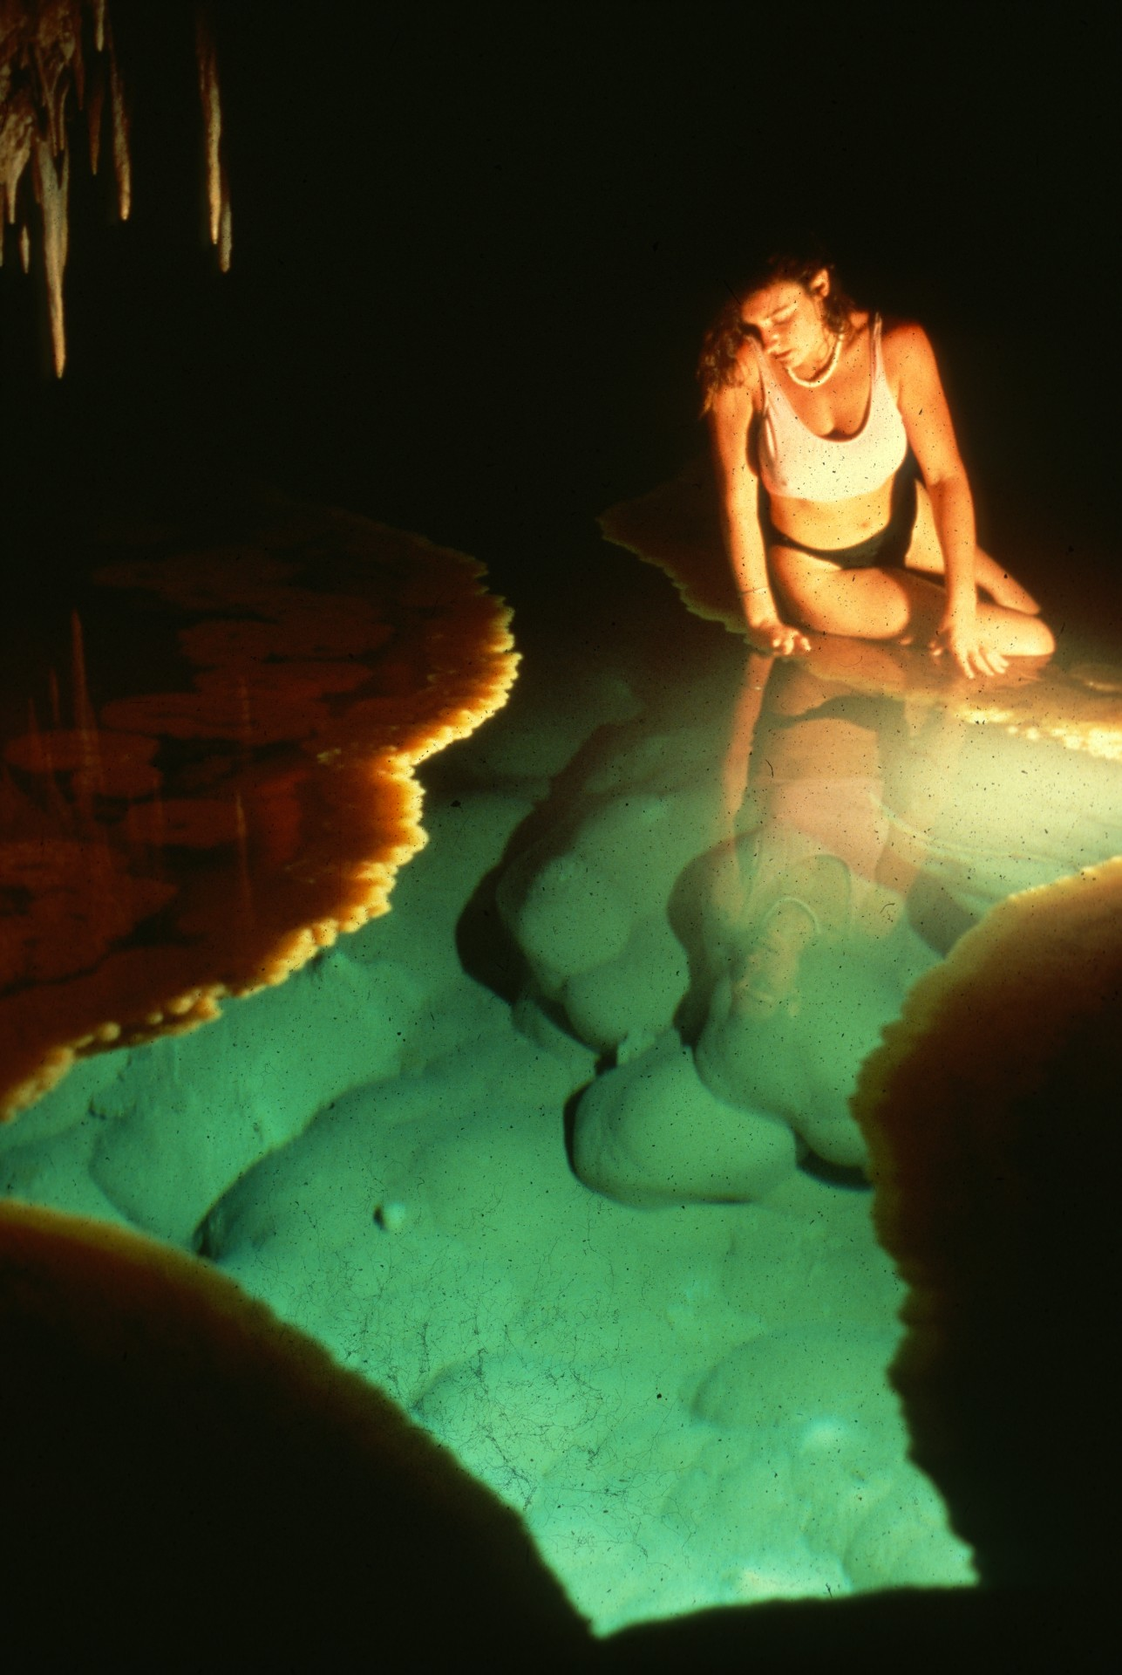
Notes:
Djuna Bewley at Lake Castrovalva – Norman Thompson

Slide 22
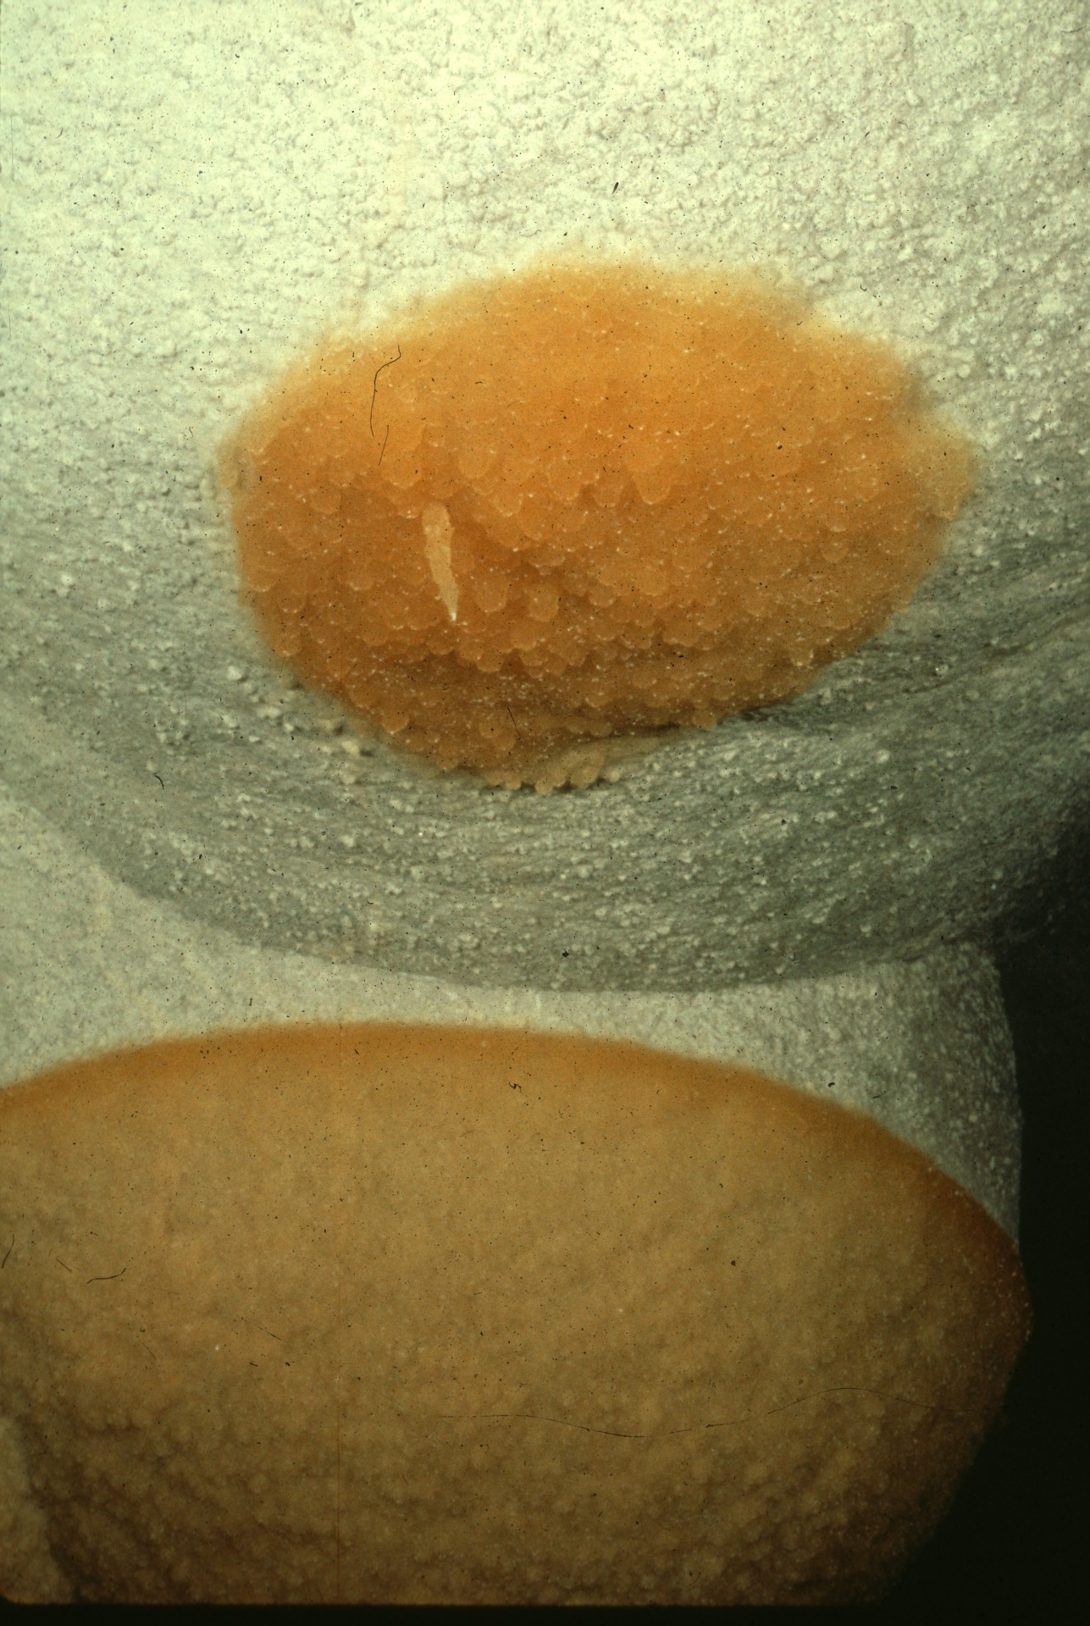
Notes:
The Water Line – Peter and Ann Bosted

Slide 23
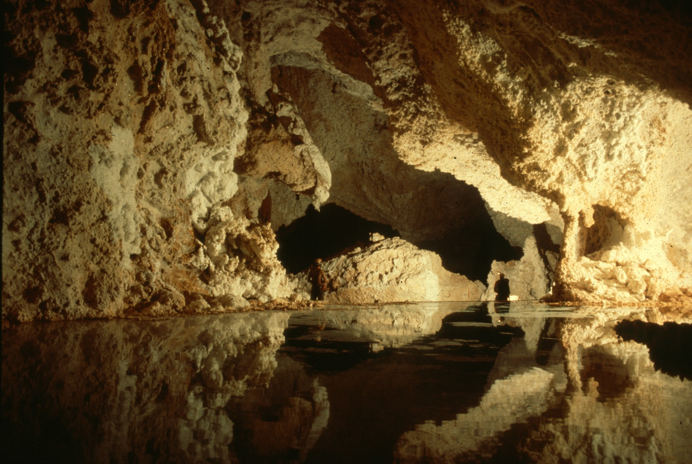
Notes:
Shades of Stillness – Bill Storage and Roland Vinyard

Slide 24
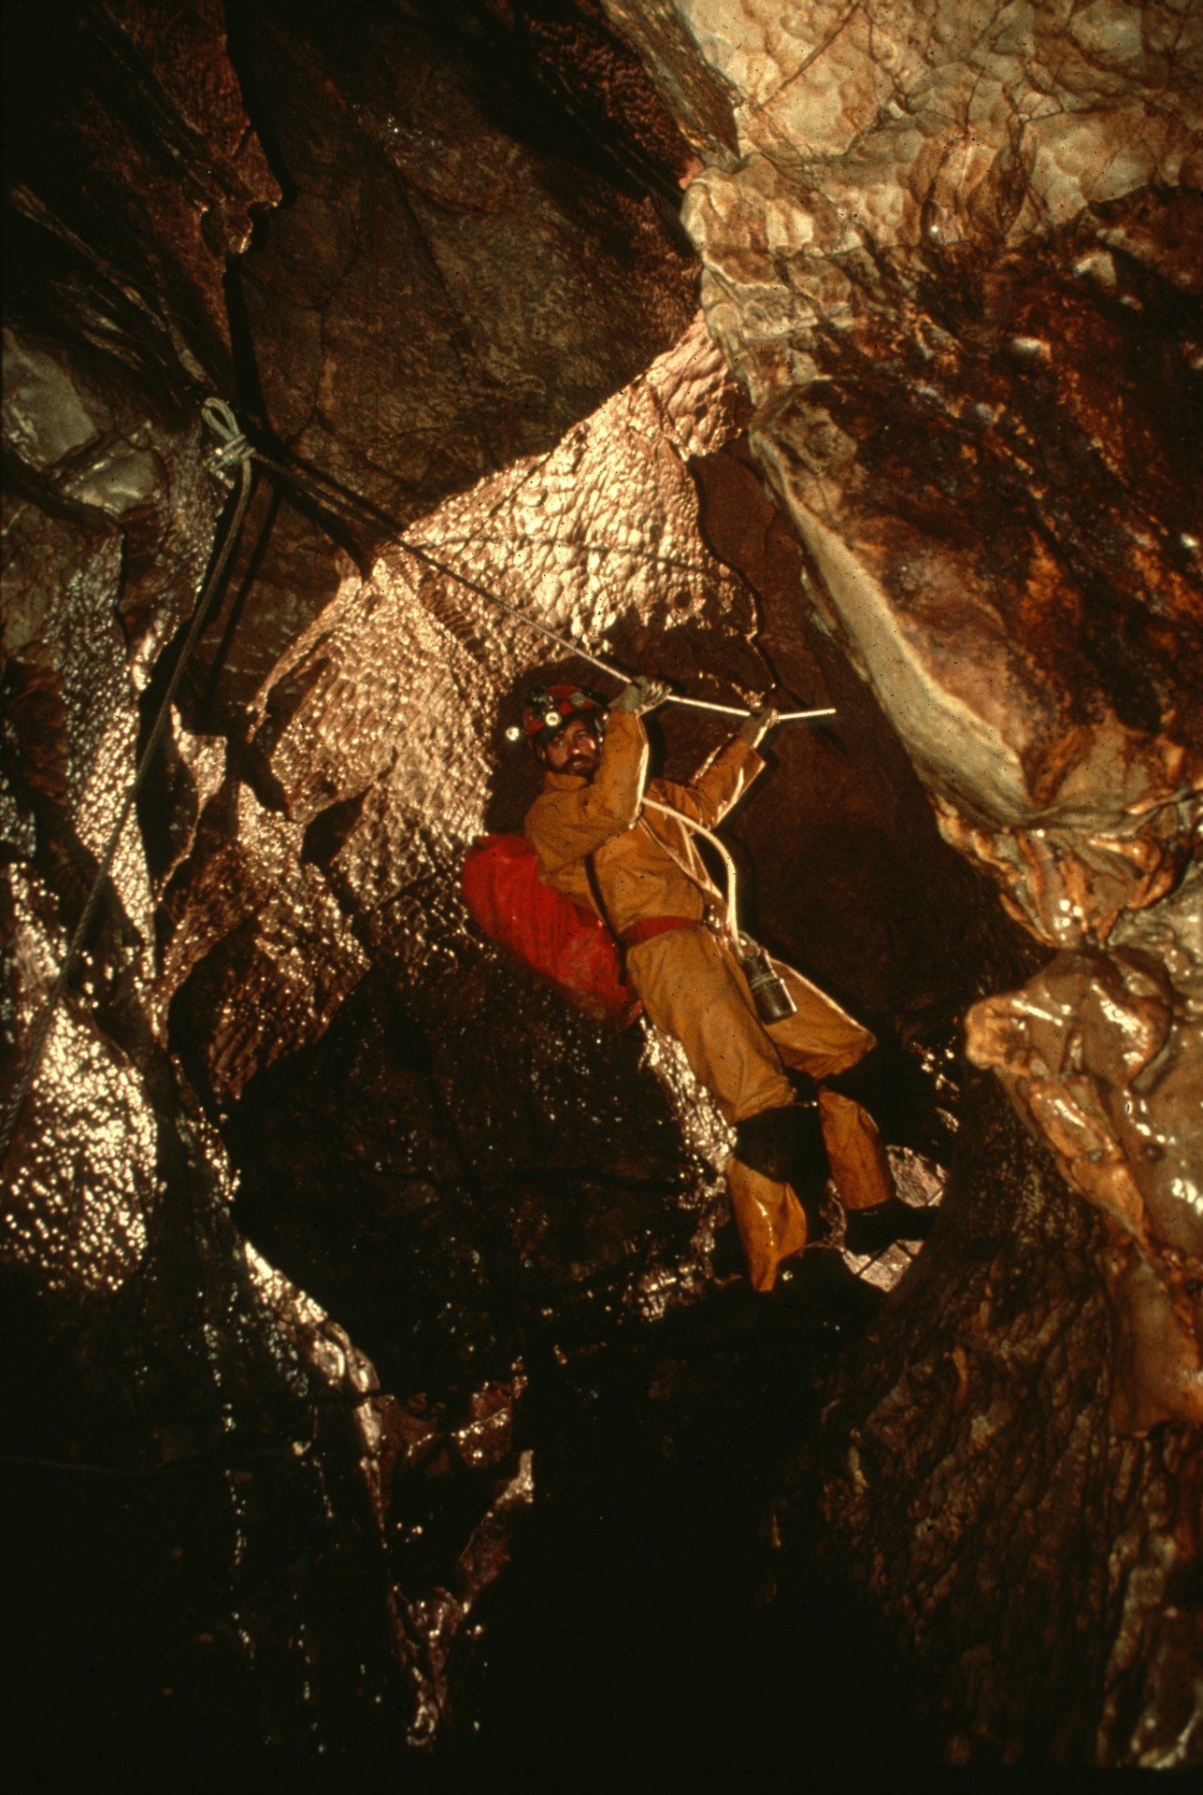
Notes:
The Cable Crossing – Peter and Ann Bosted

Slide 25
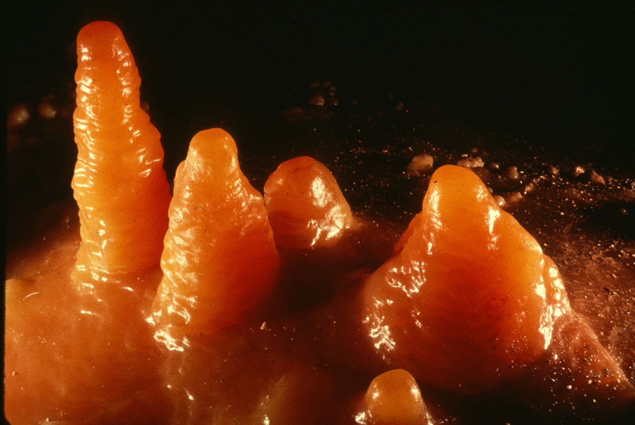
Notes:
Floor Mites – Peter and Ann Bosted

Slide 26
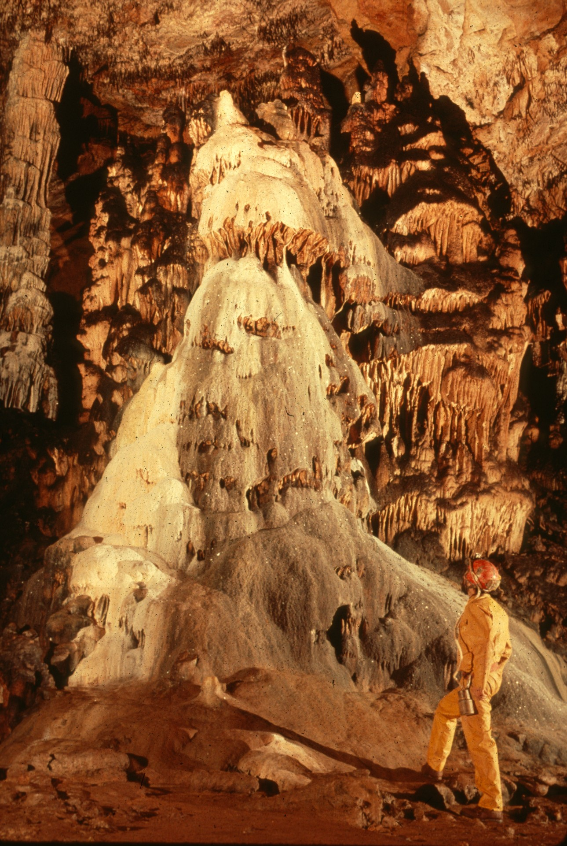
Notes:
The Diamond – Peter and Ann Bosted

Slide 27
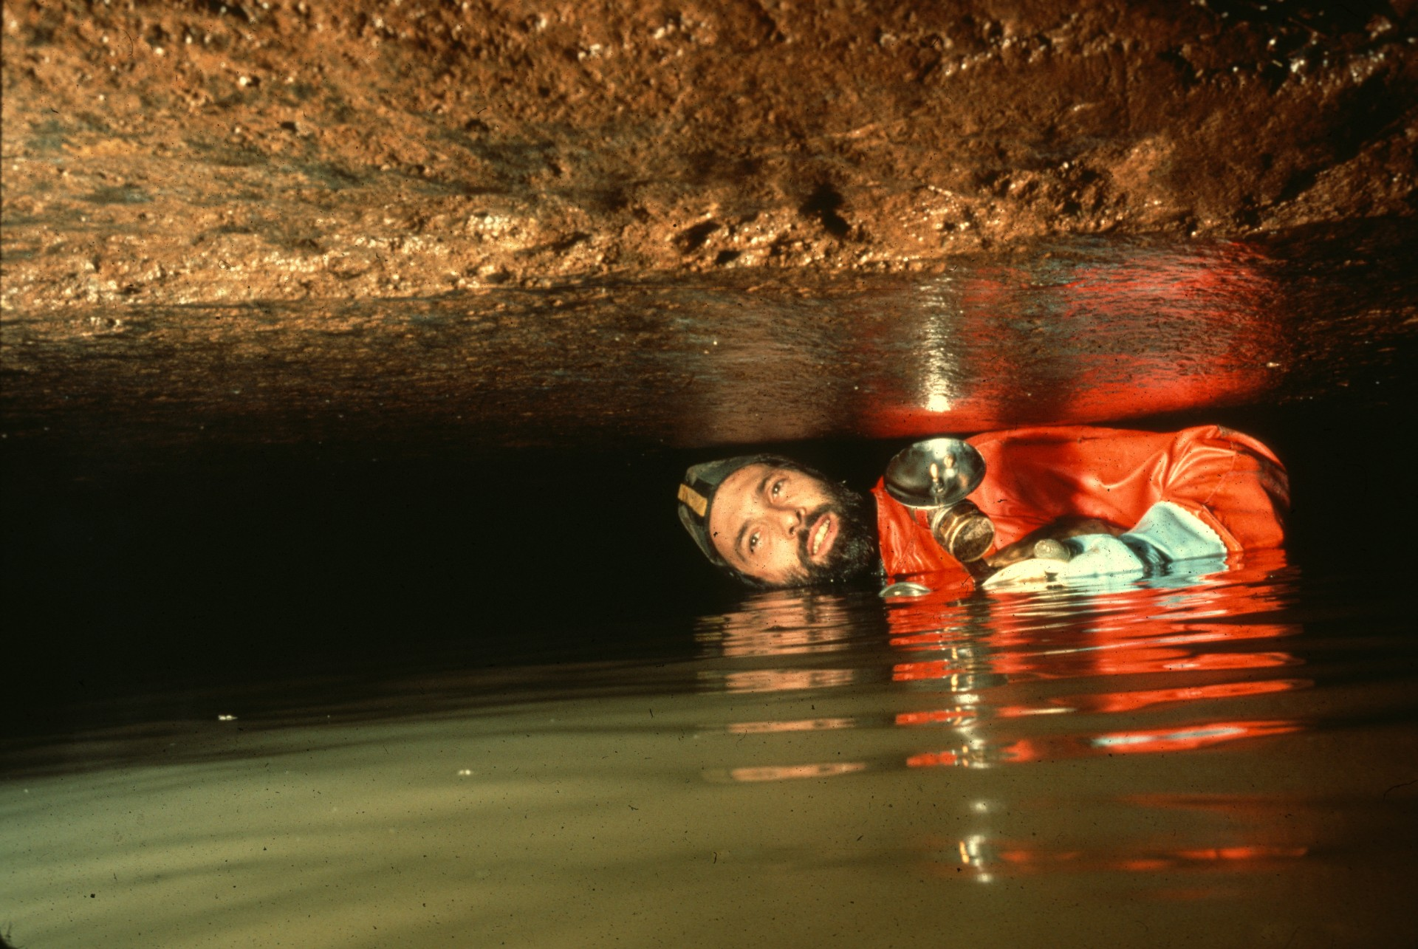
Notes:
In His Element – Ron Simmons

Slide 28
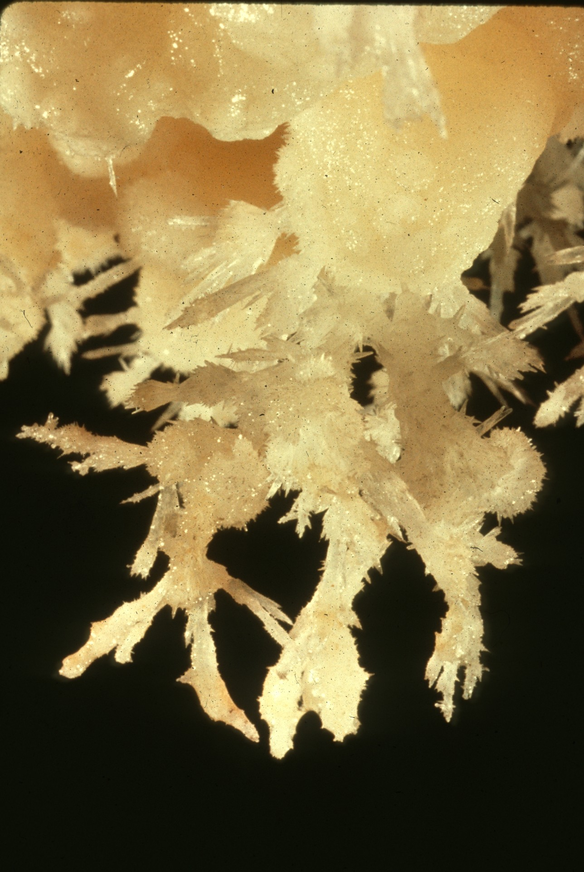
Notes:
The Light Touch – Peter and Ann Bosted

Slide 29
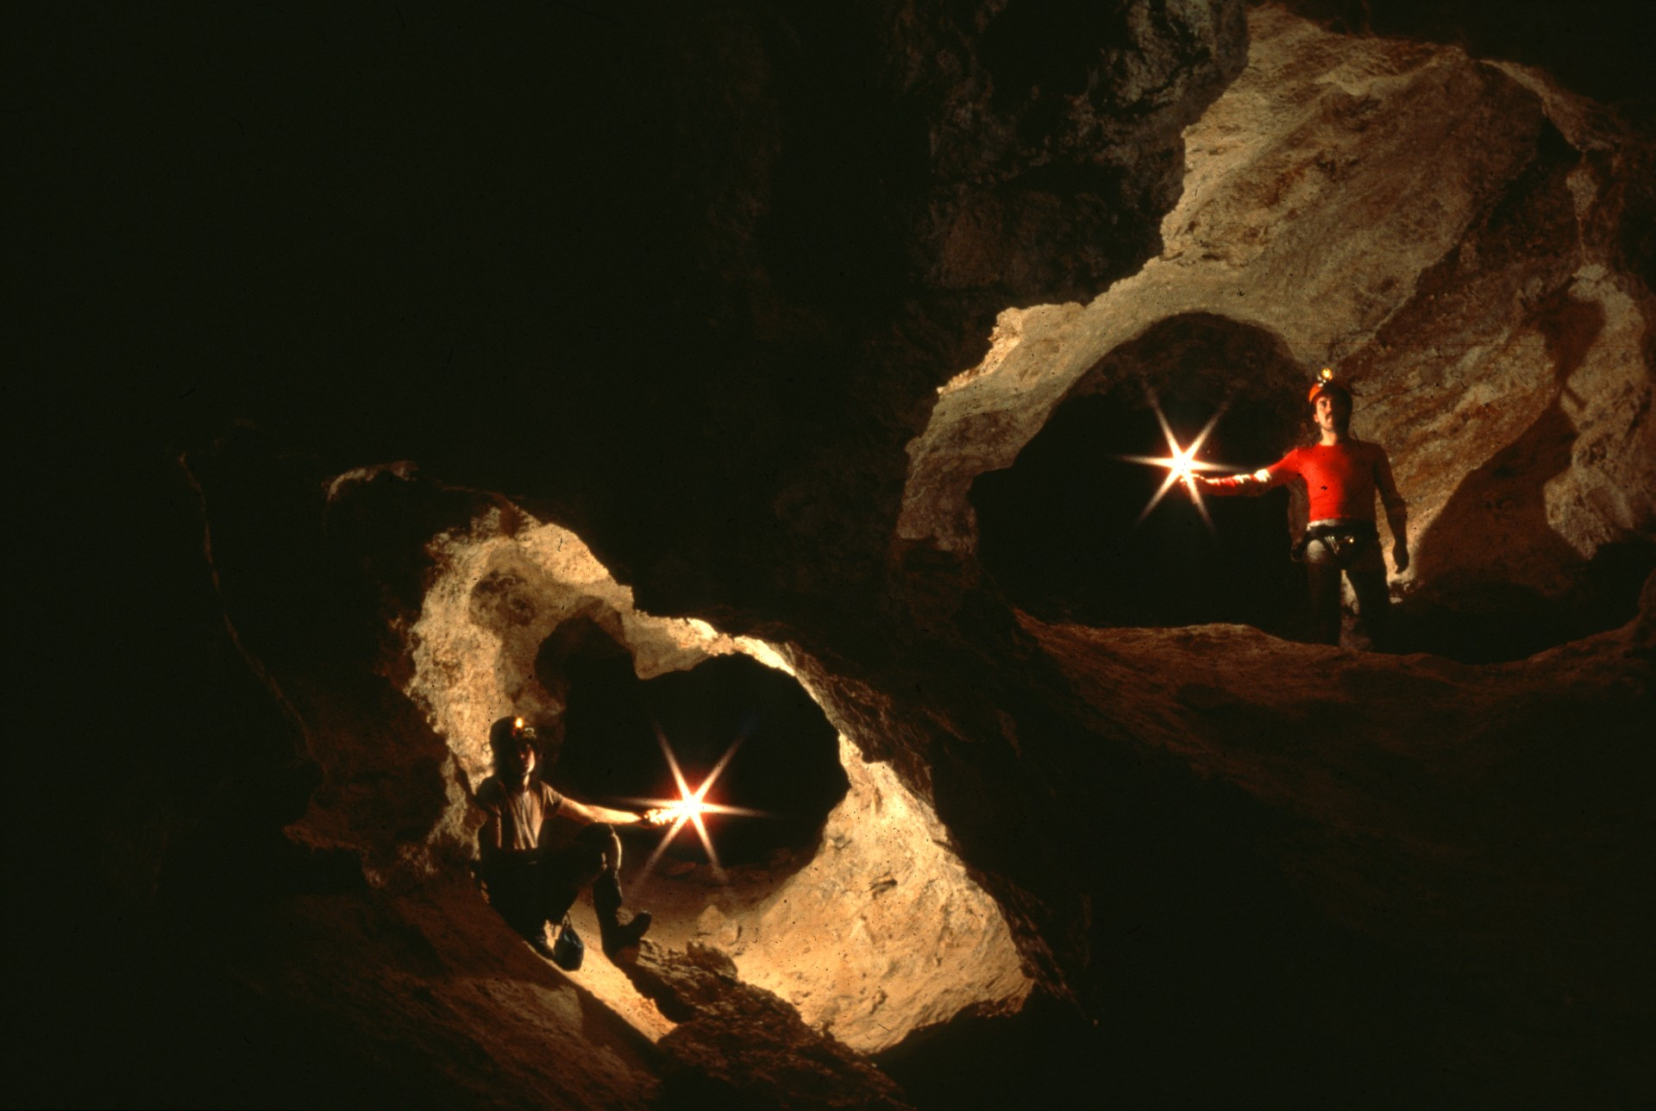
Notes:
Boneyard – Jim Loftin

Slide 30
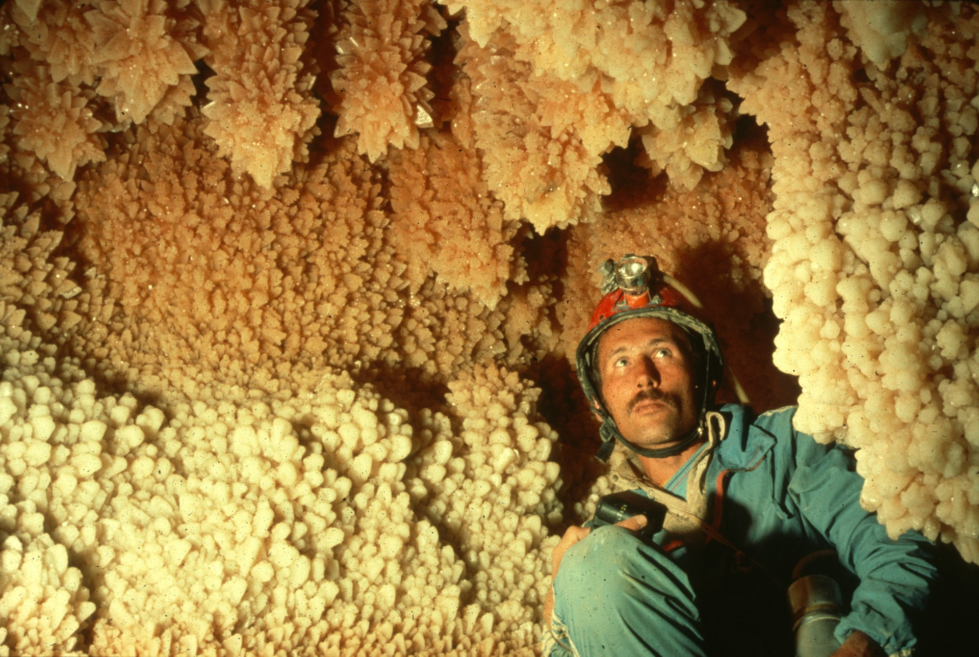
Notes:
Misu’s Discovery – Carolyn Cronk

Slide 31
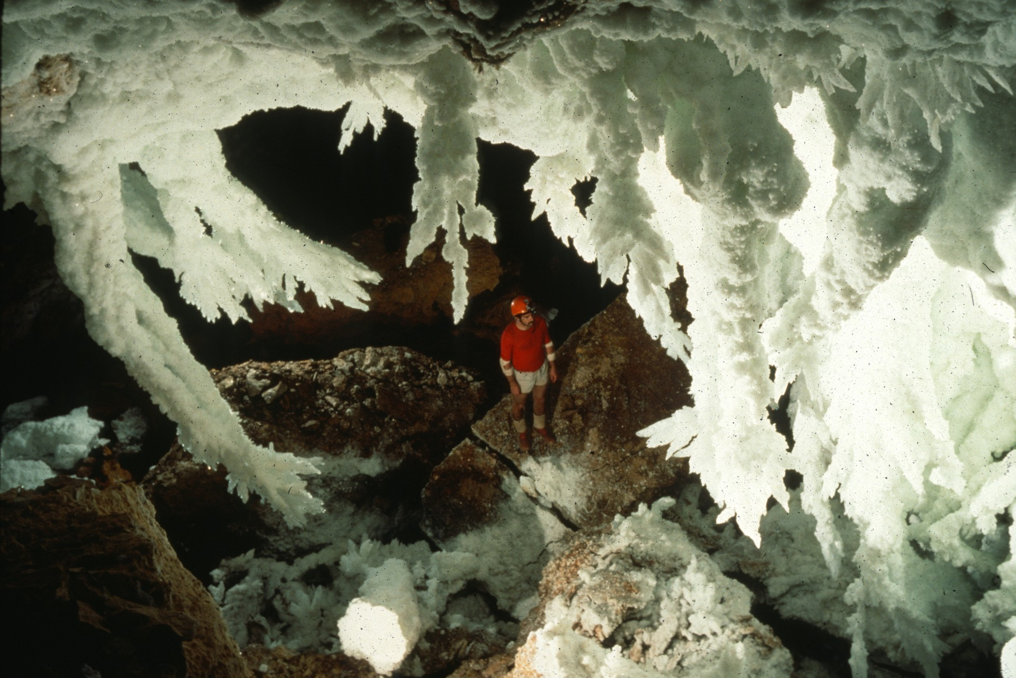
Notes:
Comely Delight – Jim Loftin

Slide 32
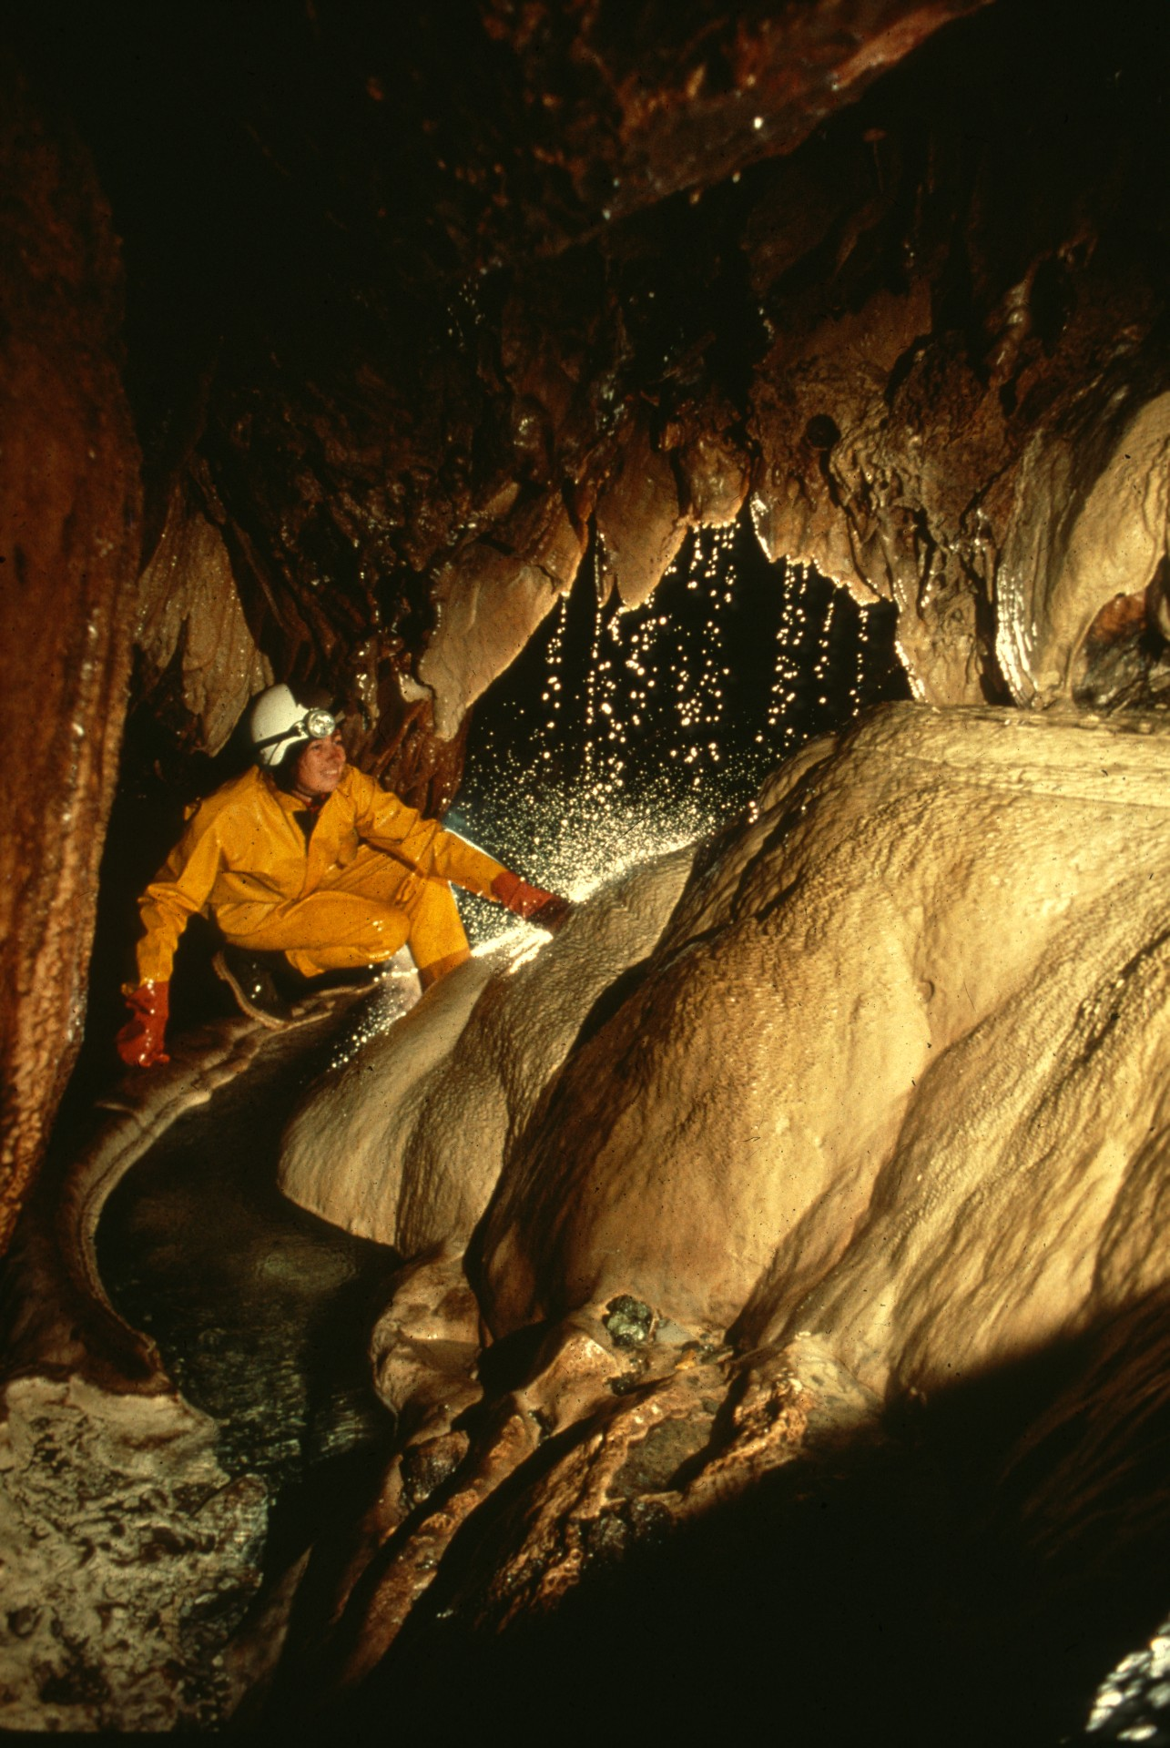
Notes:
Drop City – Peter and Ann Bosted

Slide 33
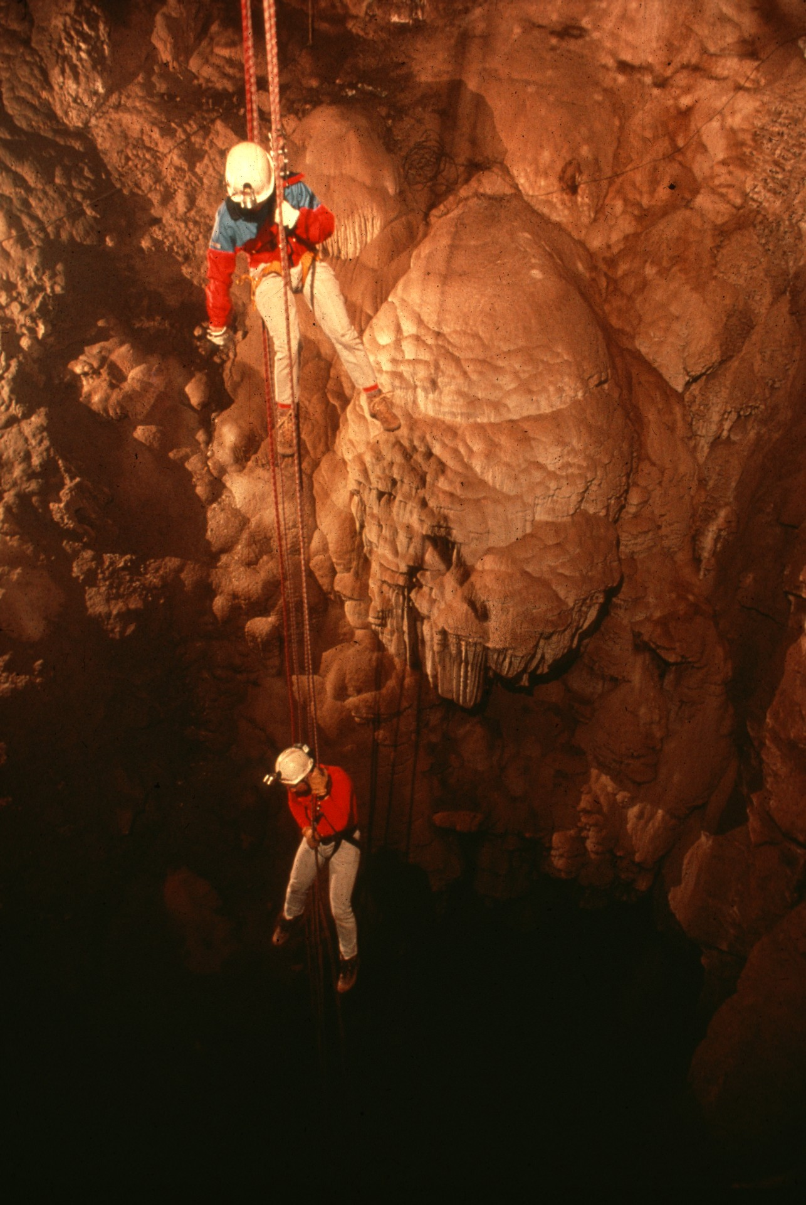
Notes:
Double Rappel – Peter and Ann Bosted

Slide 34
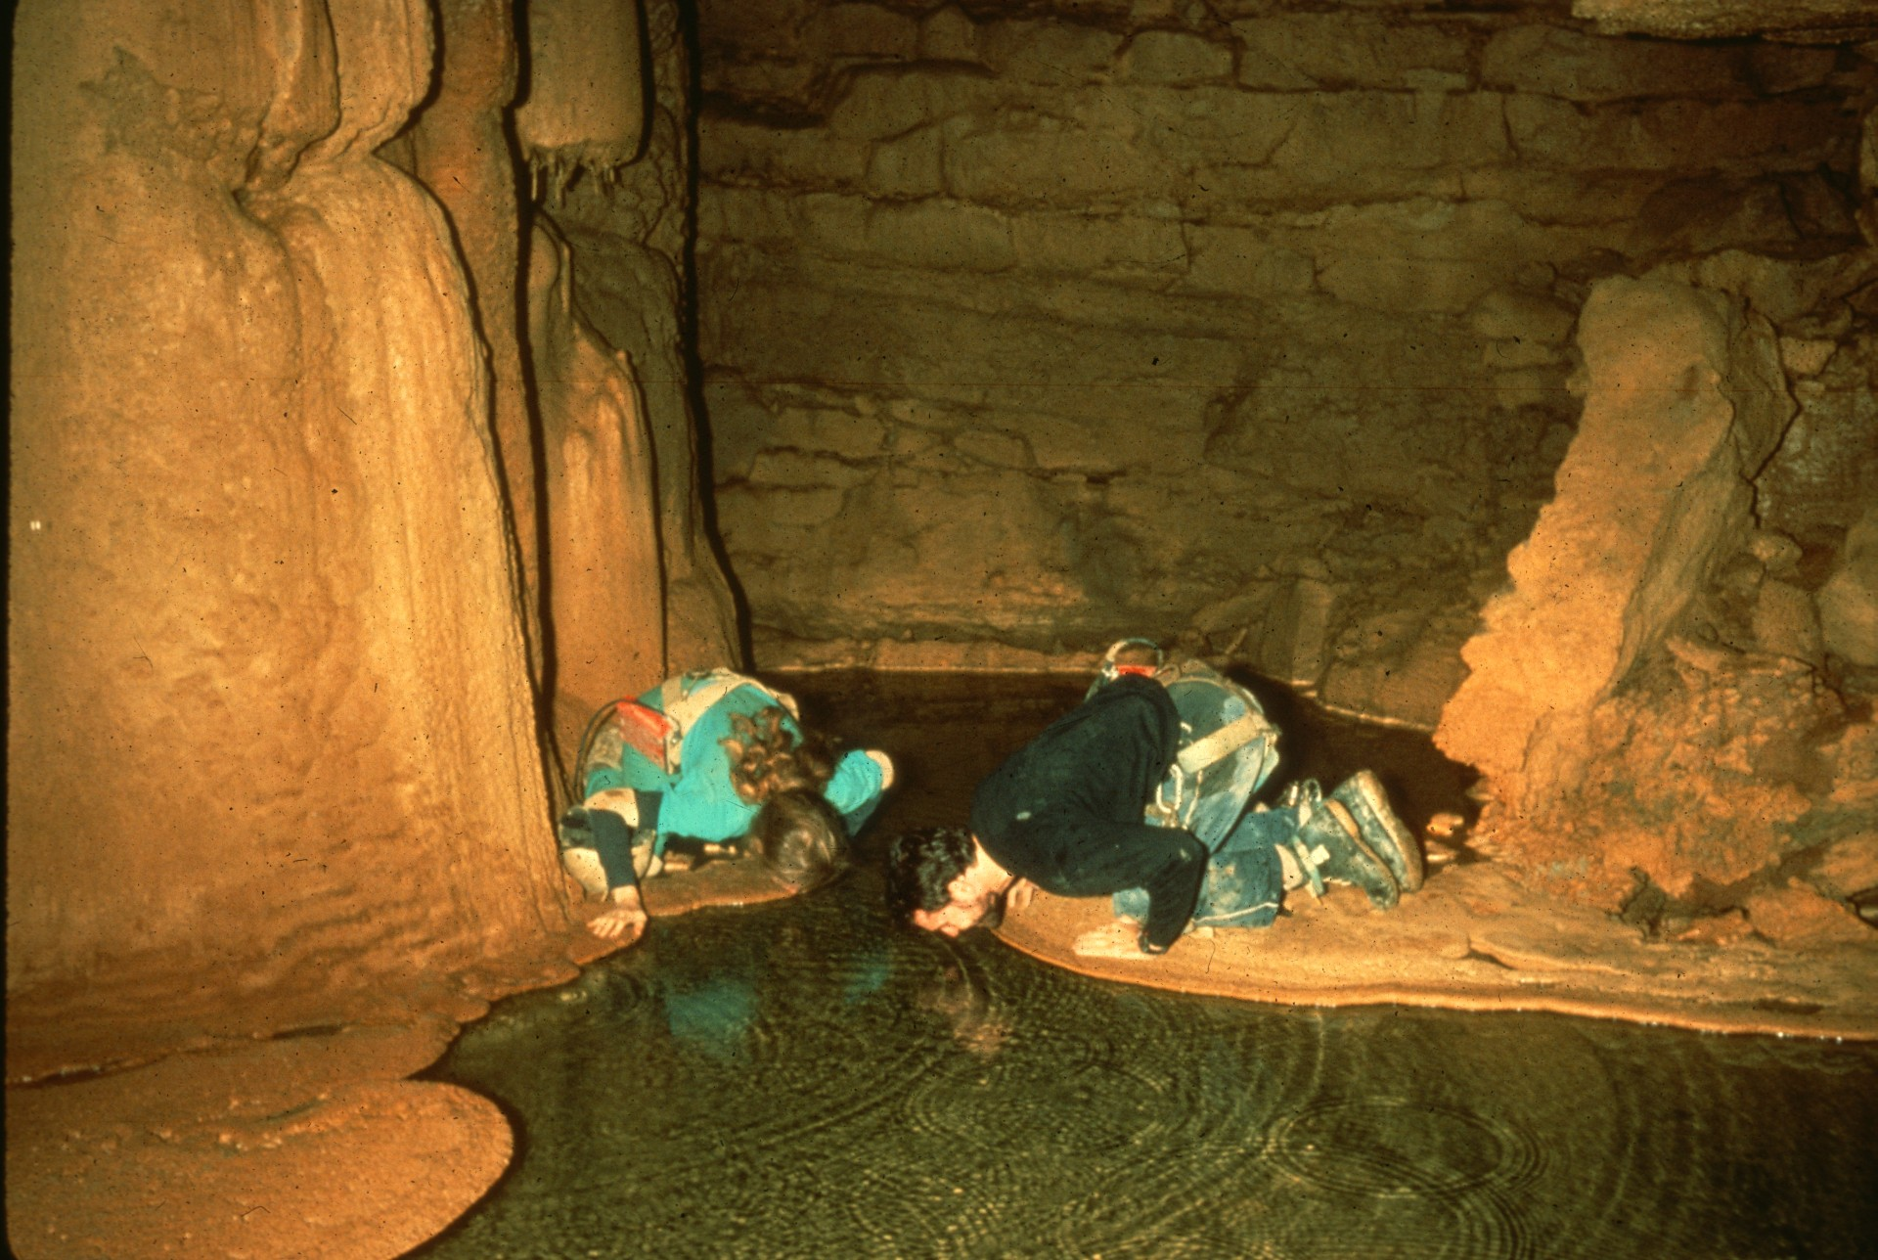
Notes:
Bobbing for Crayfish – John Van Swearingen, IV and Bob Loney

Slide 35
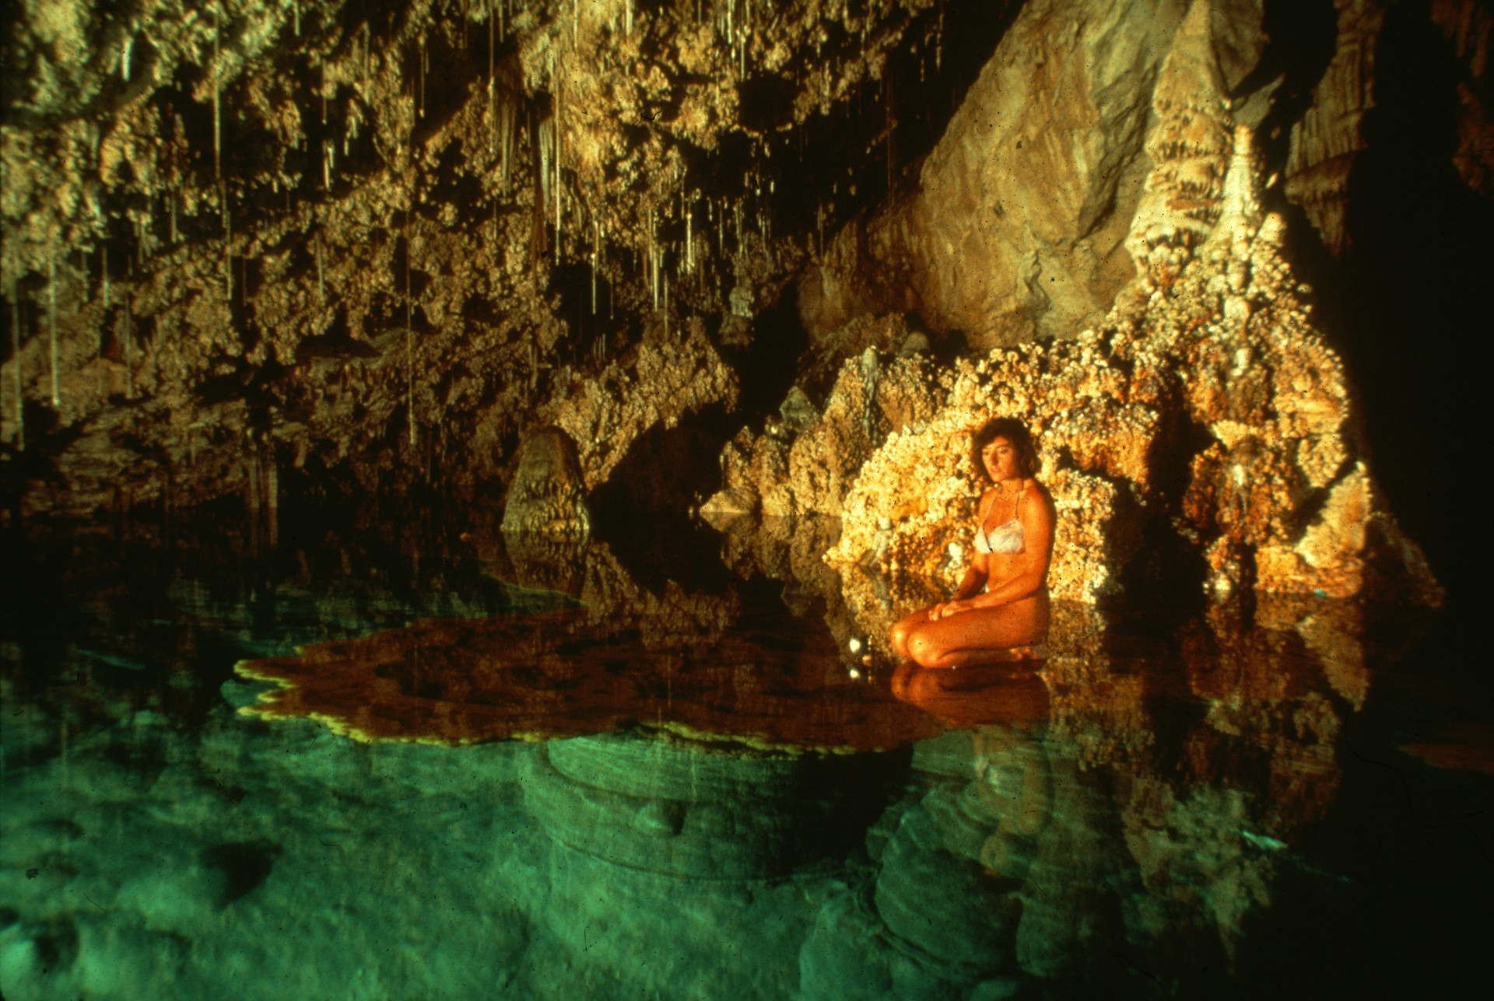
Notes:
Nymph of the Crimson Isle – Dave Bunnell

Slide 36
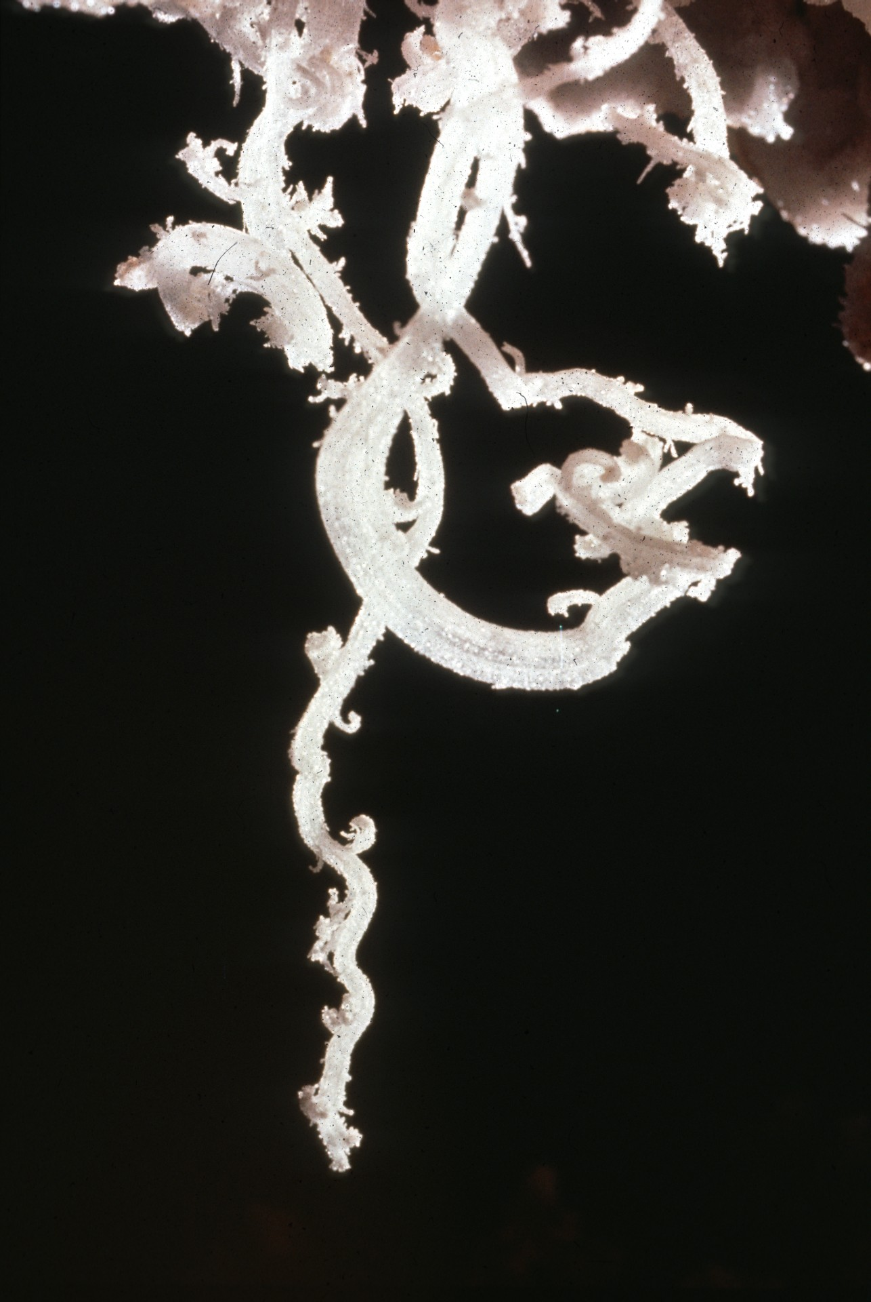
Notes:
Gypsum Flower – Peter and Ann Bosted

Slide 37
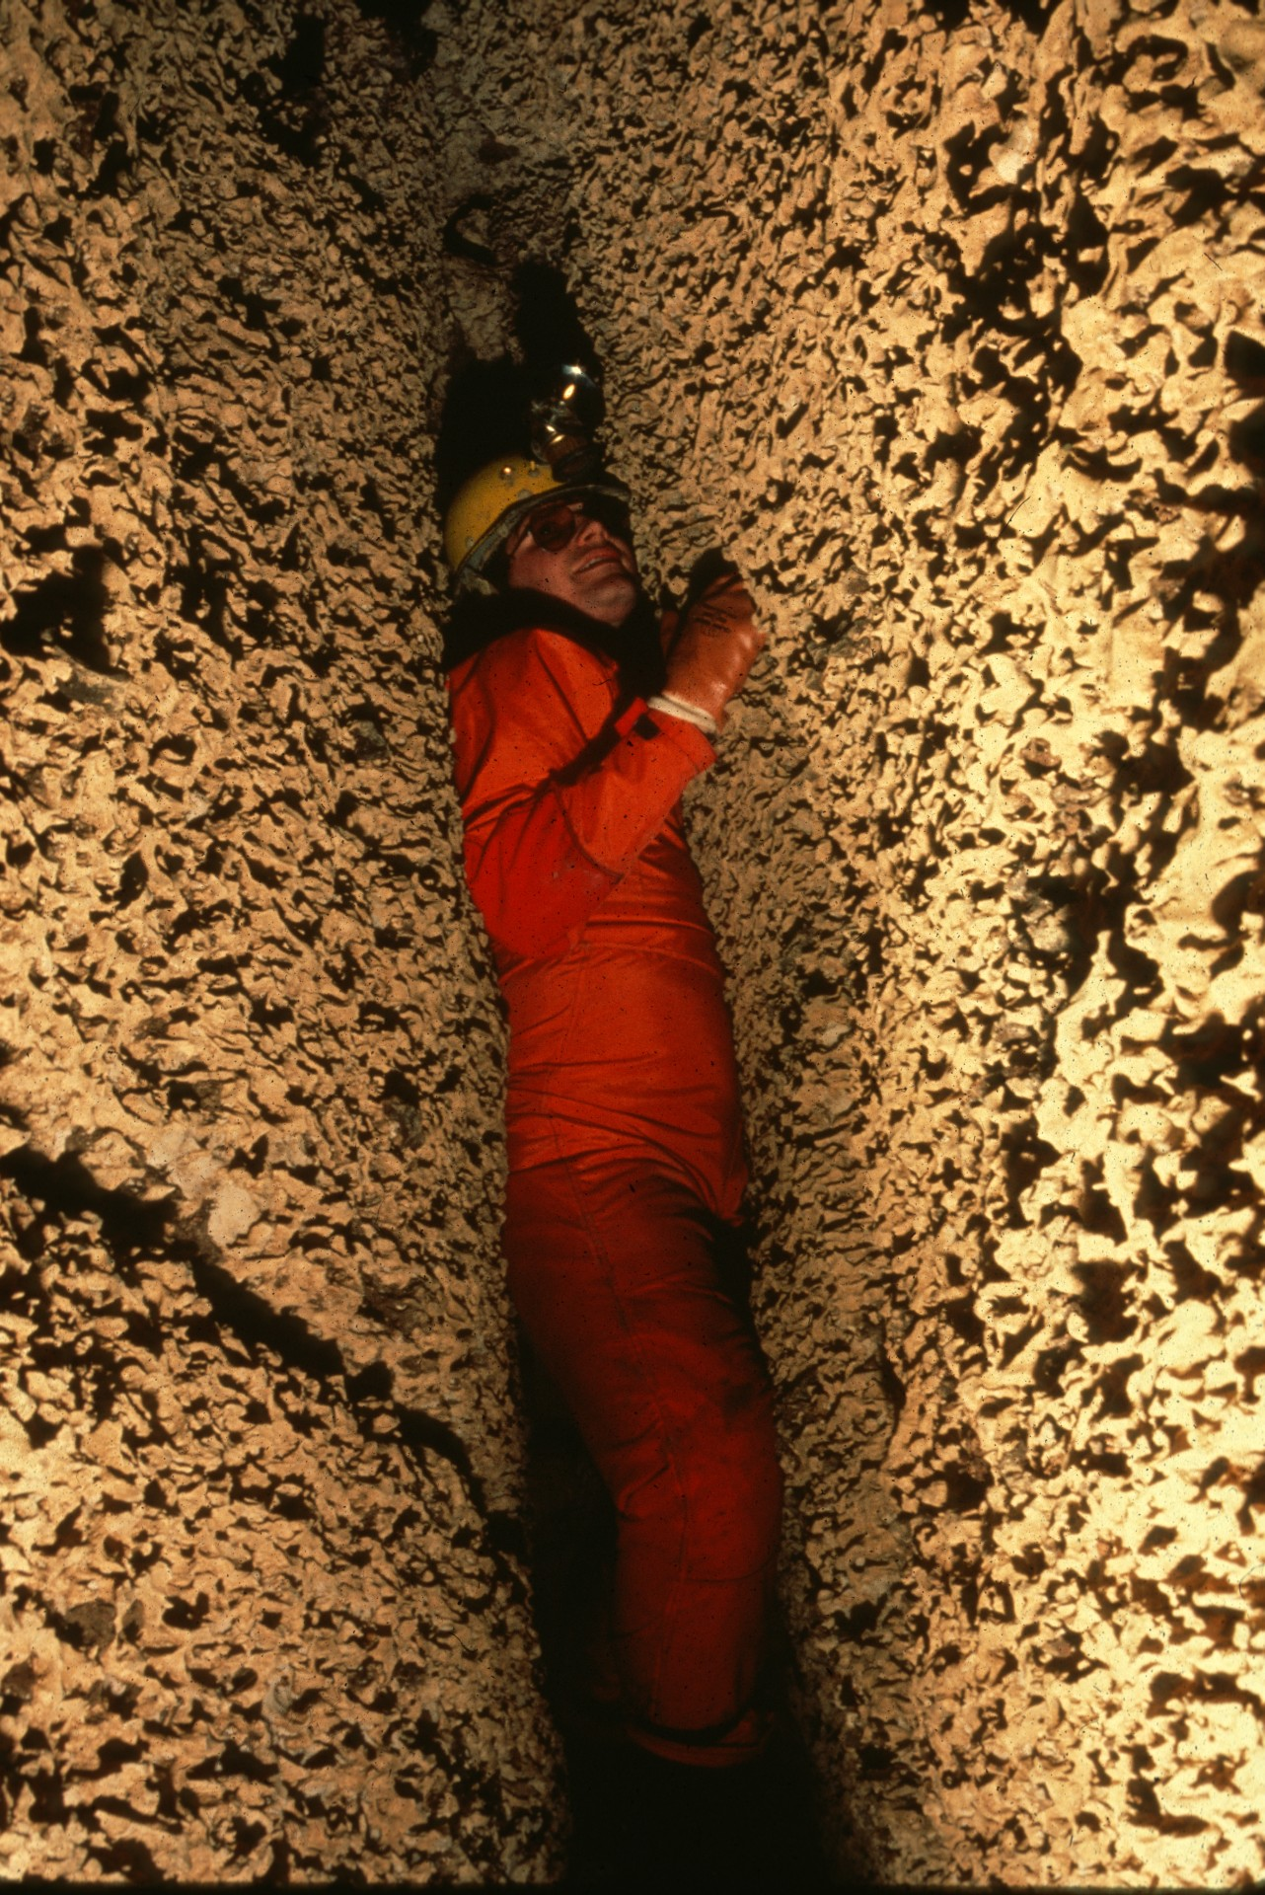
Notes:
Between a Rock and a Hard Place – Ron Simmons

Slide 38
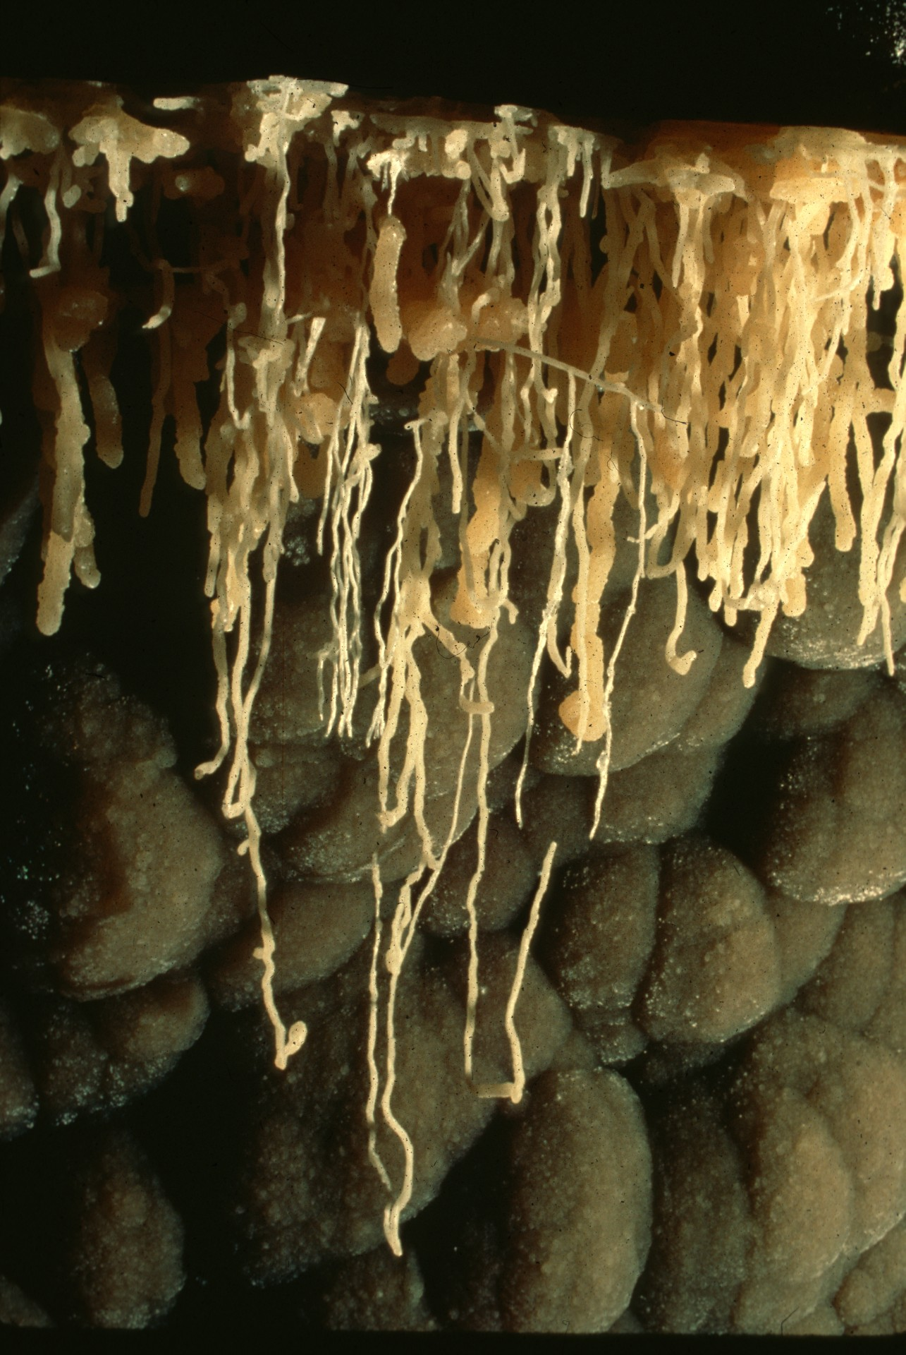
Notes:
Subaqueous Helictites 2 – Dave Bunnell and Djuna Bewley

Slide 39
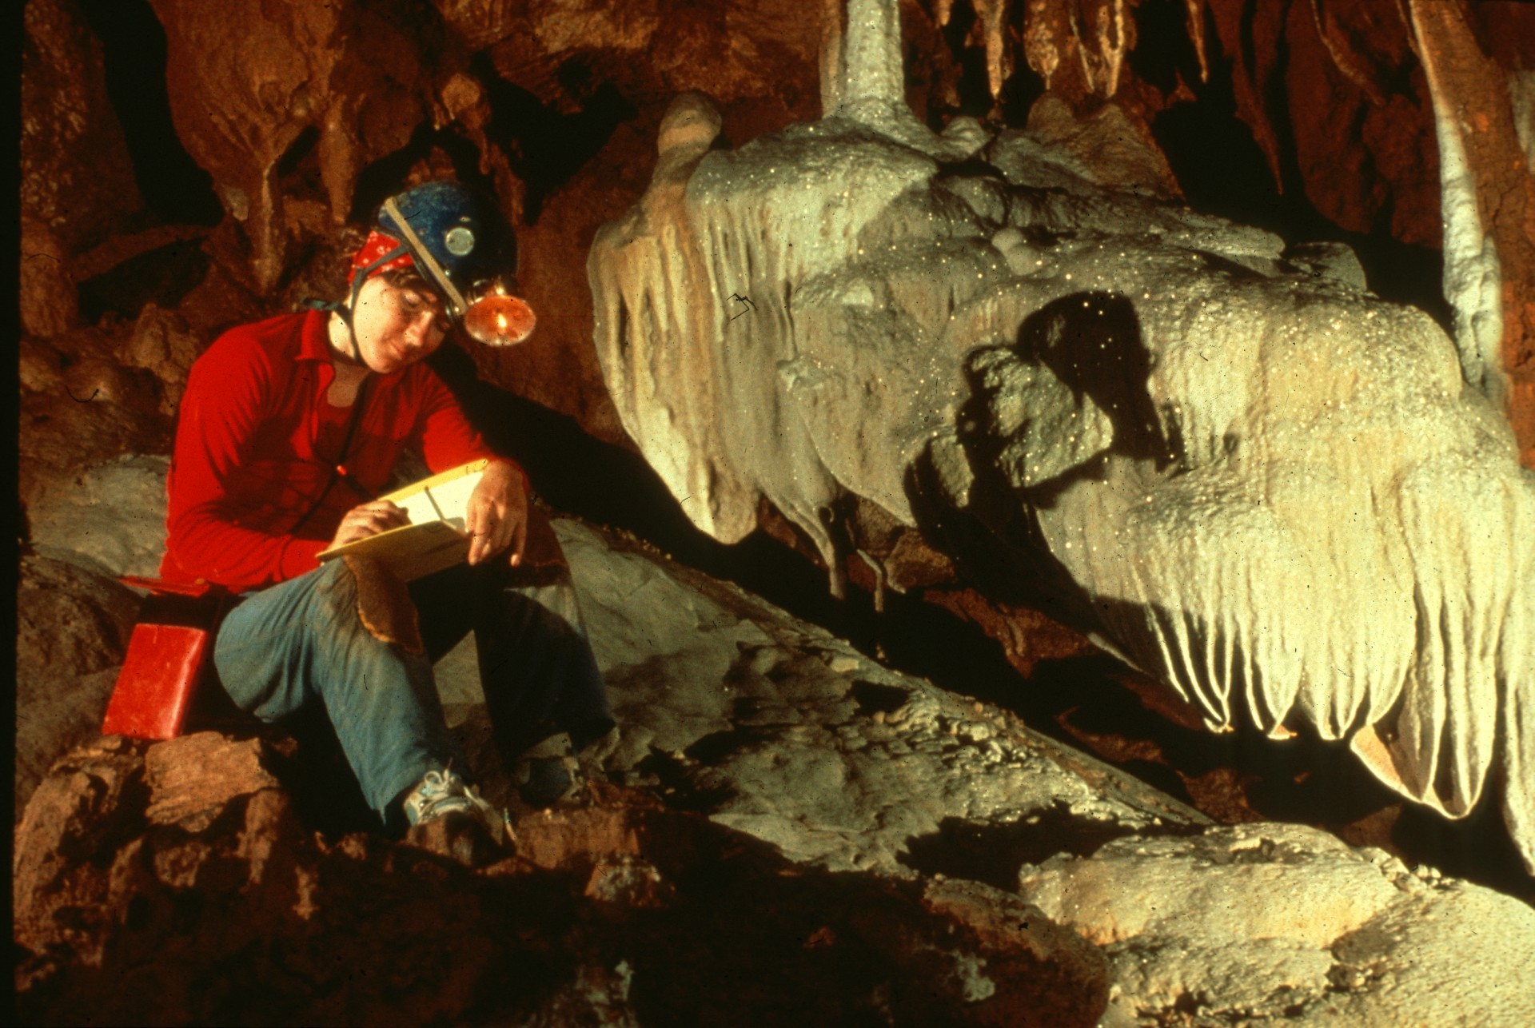
Notes:
A Sketcher’s Paradise – Peter Bosted

Slide 40
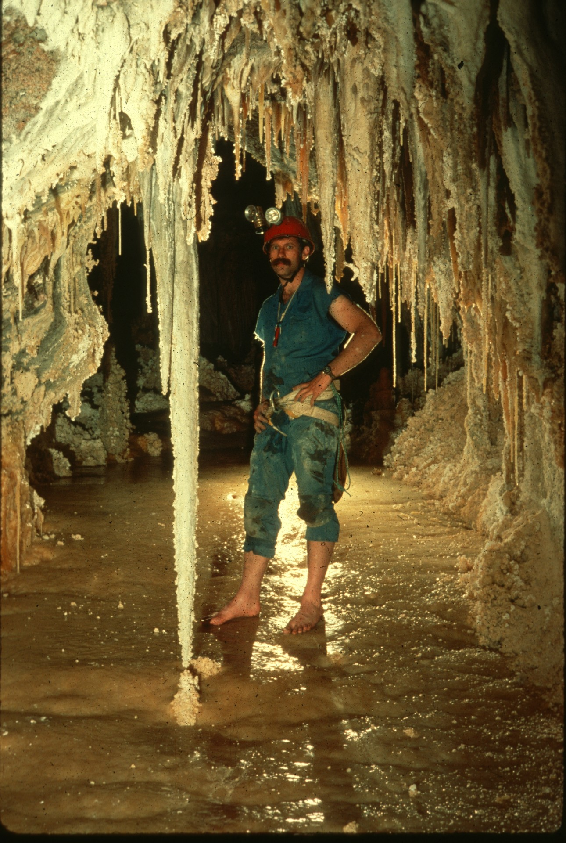
Notes:
Barefoot Caving – Dick Laforge and Charles Festersen

Slide 41
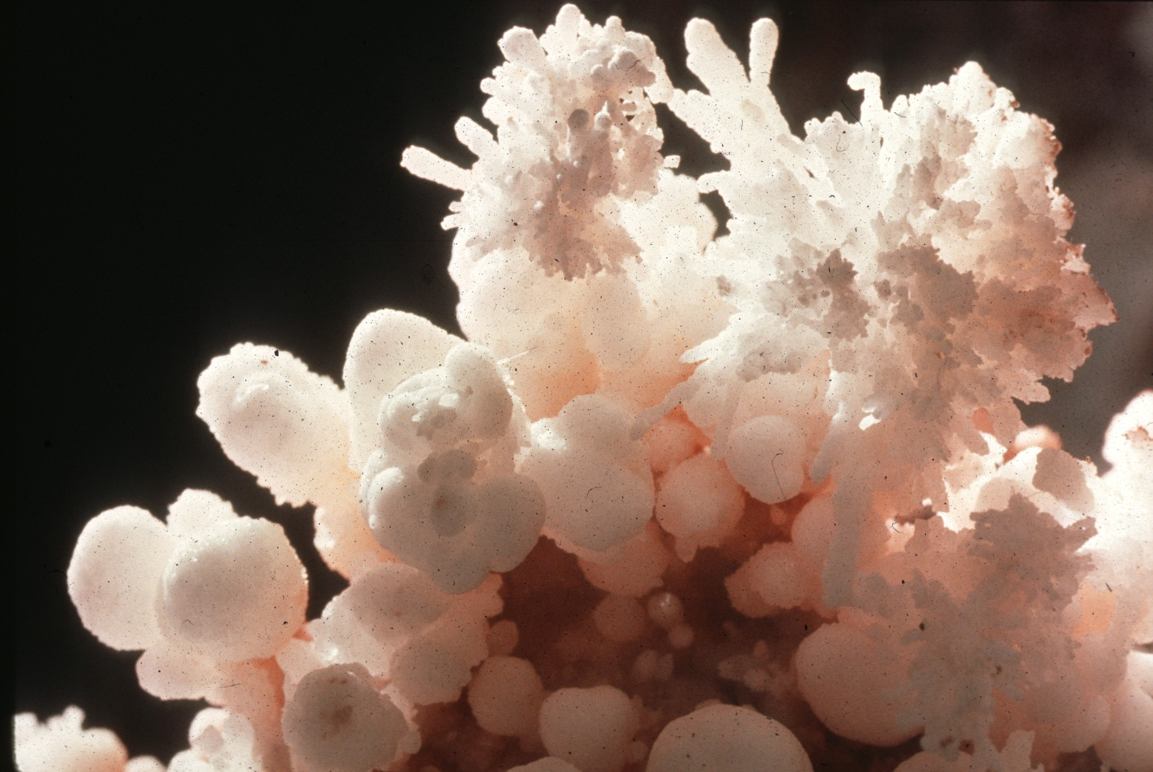
Notes:
Pink Roots – Peter and Ann Bosted

Slide 42
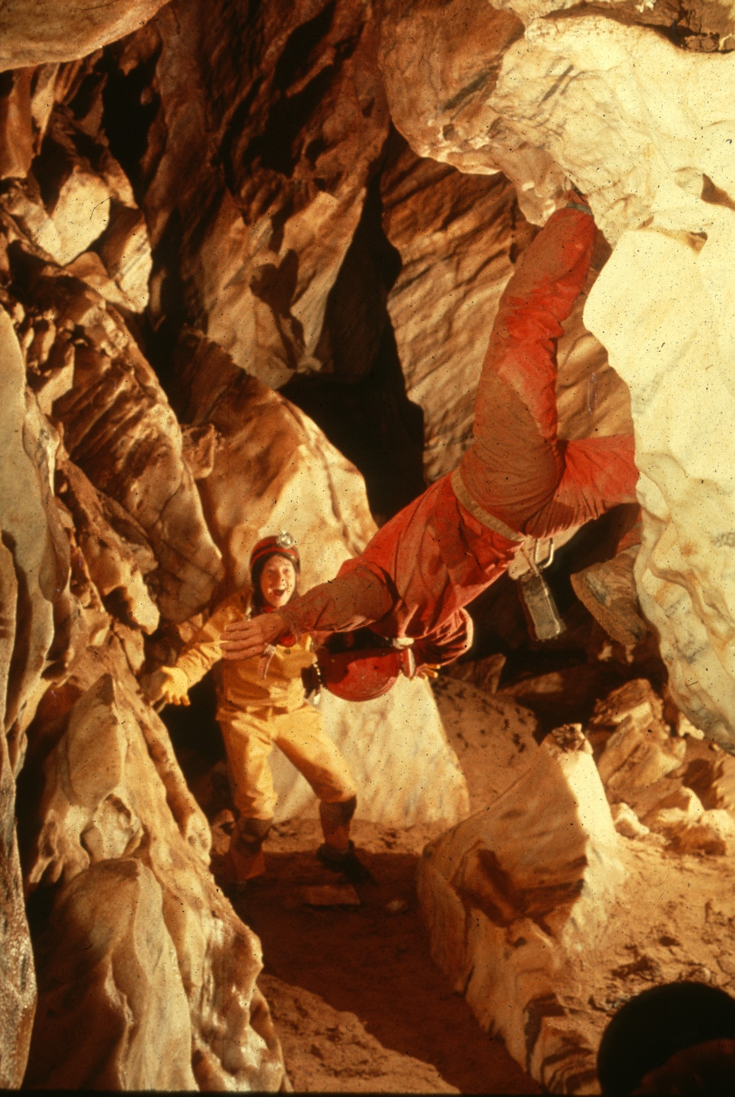
Notes:
Help!! – Peter and Ann Bosted

Slide 43
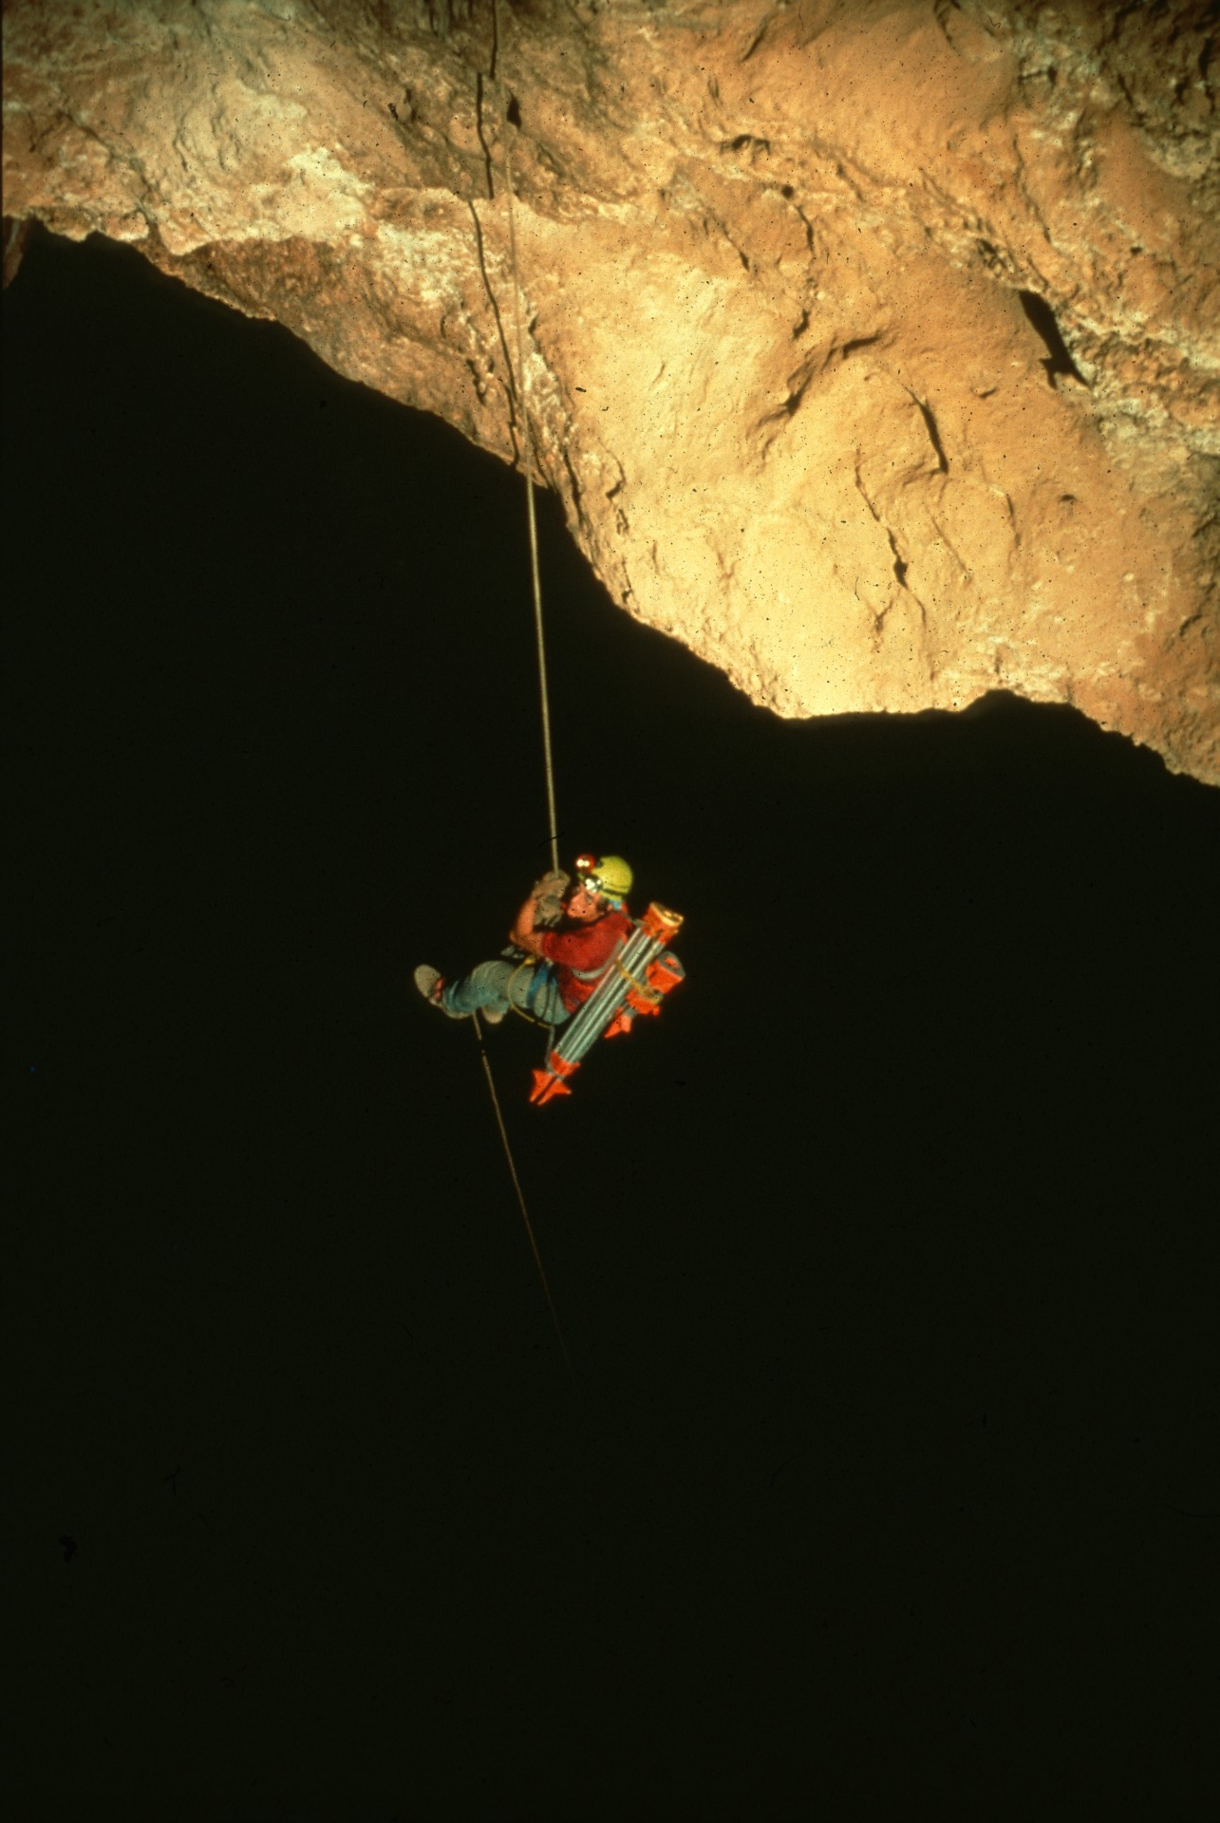
Notes:
John Patterson Ascends From the Blackness – Norman Thompson

Slide 44
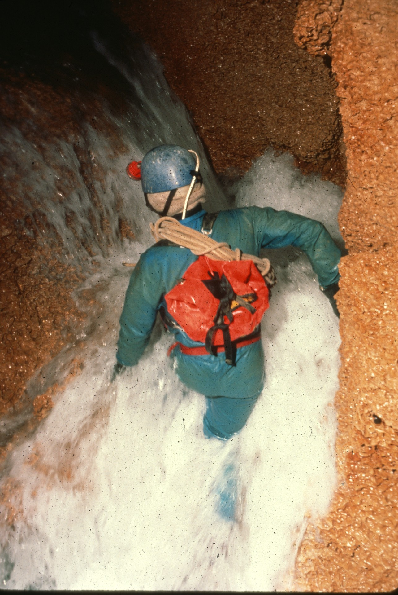
Notes:
Cascade – Ron Simmons

Slide 45
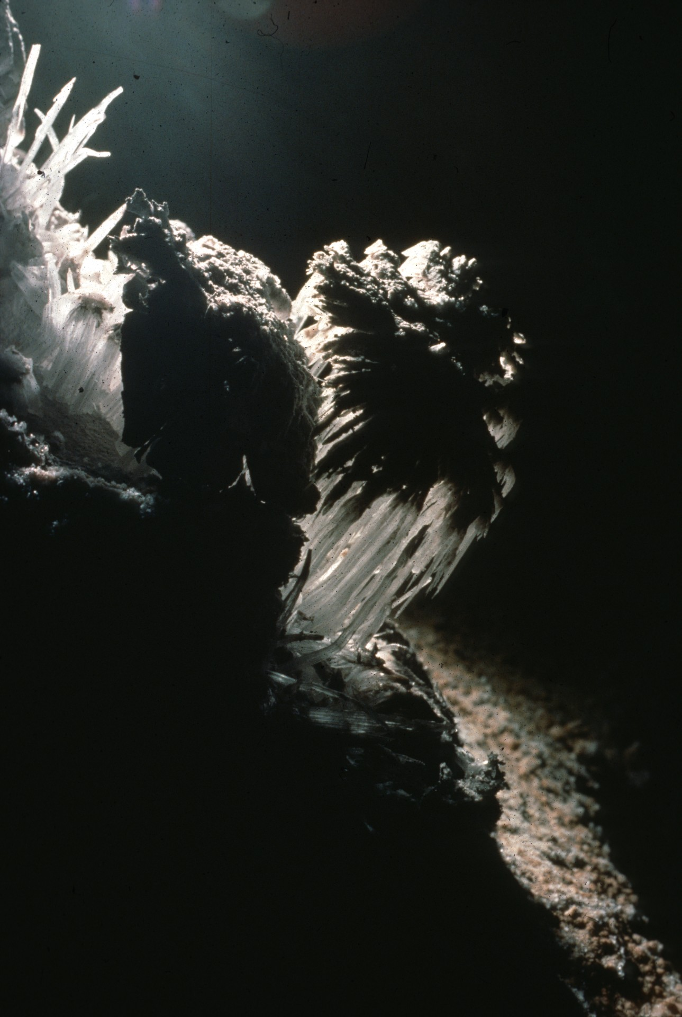
Notes:
Leaping Lunar Spiders – John Scheltens

Slide 46
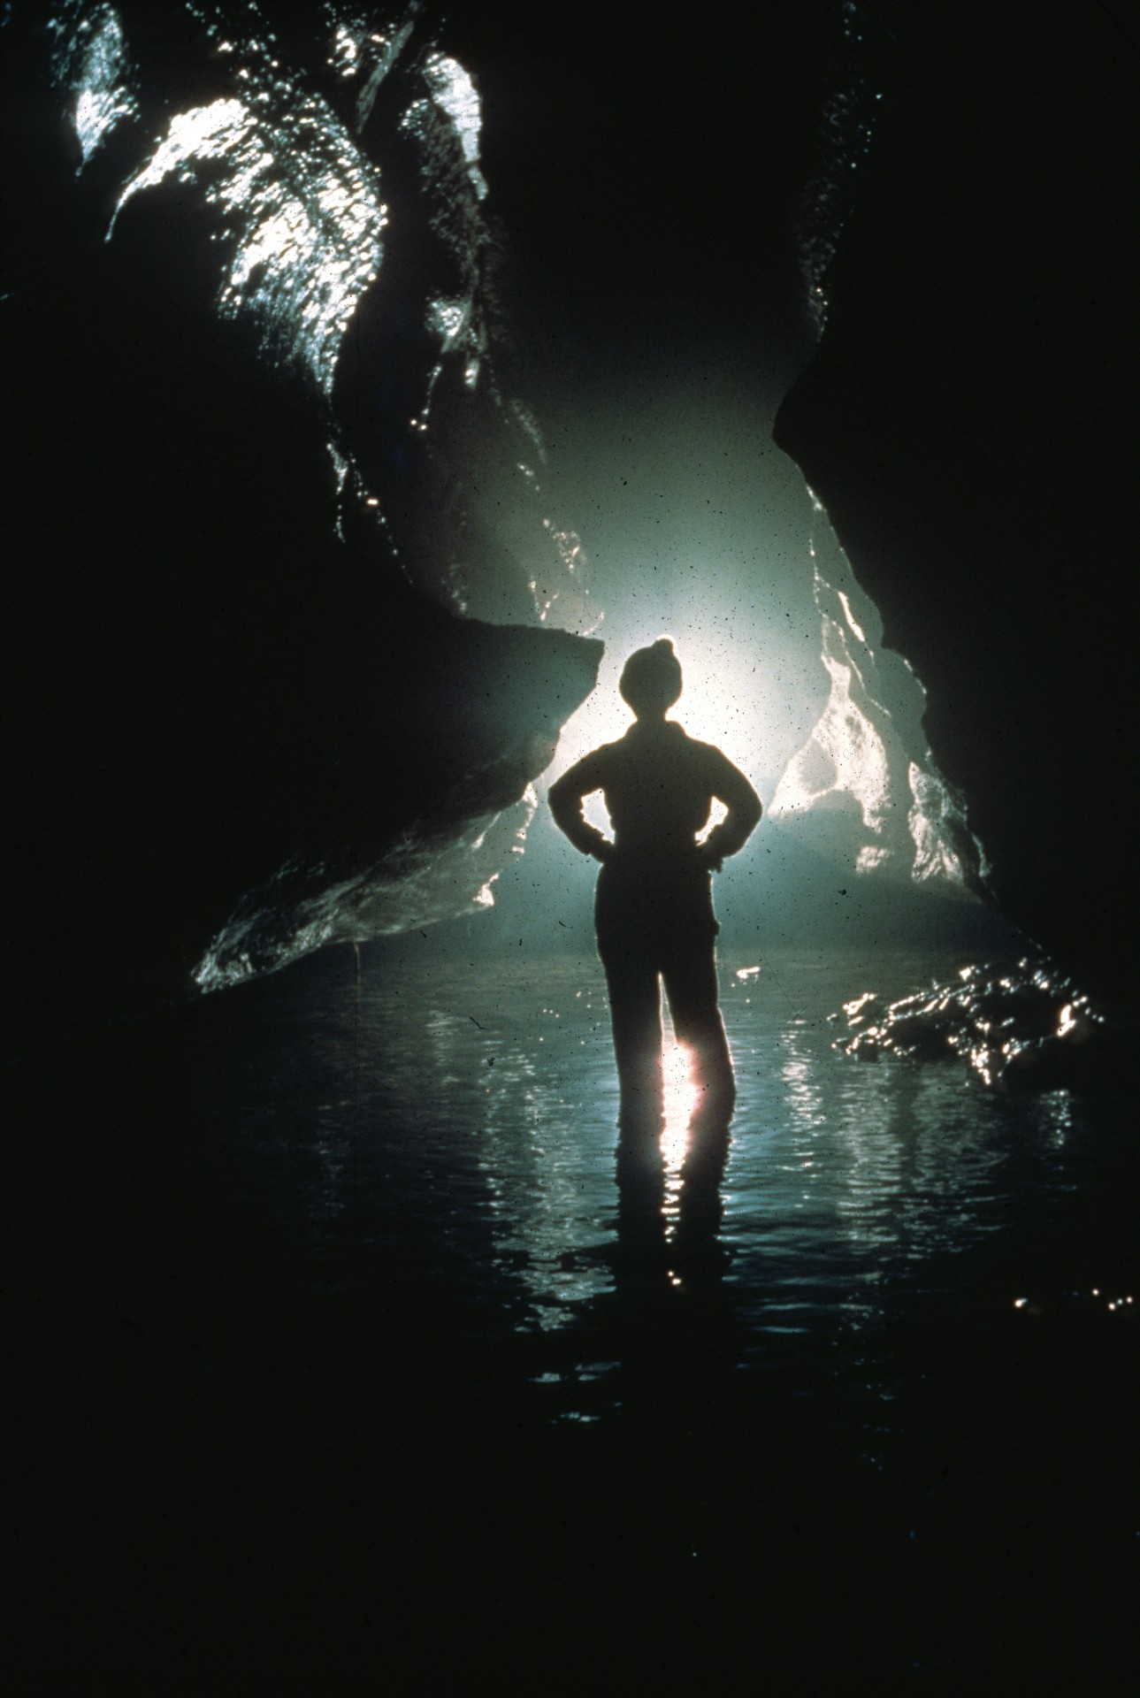
Notes:
Endless River – John Van Swearingen, IV

Slide 47

HONORABLE MENTION
PHOTO SALON

Slide 48
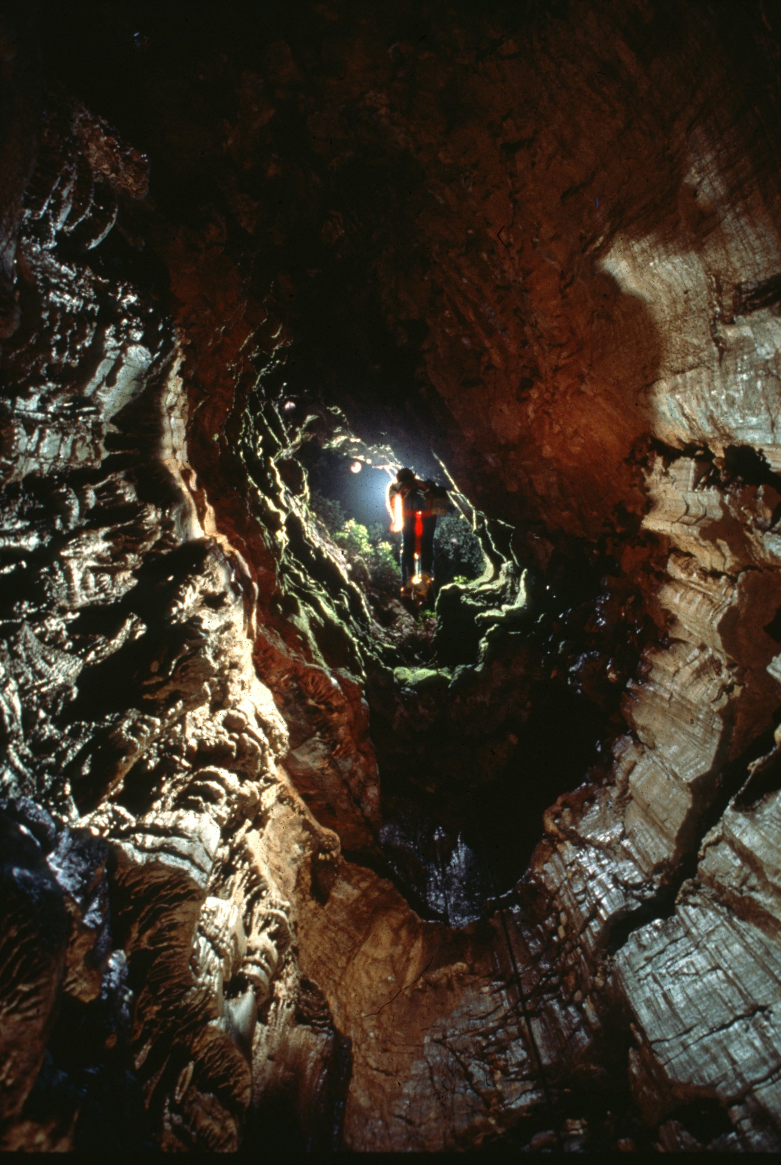
Notes:
Night – Fall – Rick Day

Slide 49
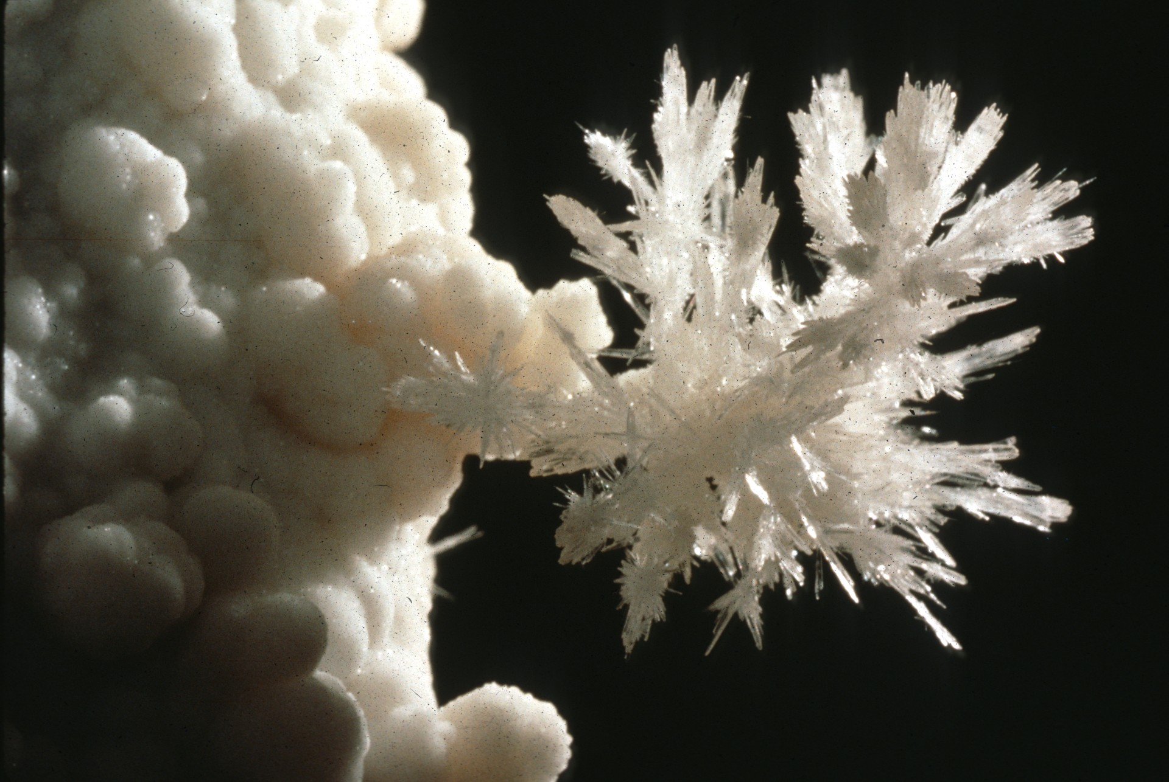
Notes:
A Gypsum Spray – Peter and Ann Bosted

Slide 50
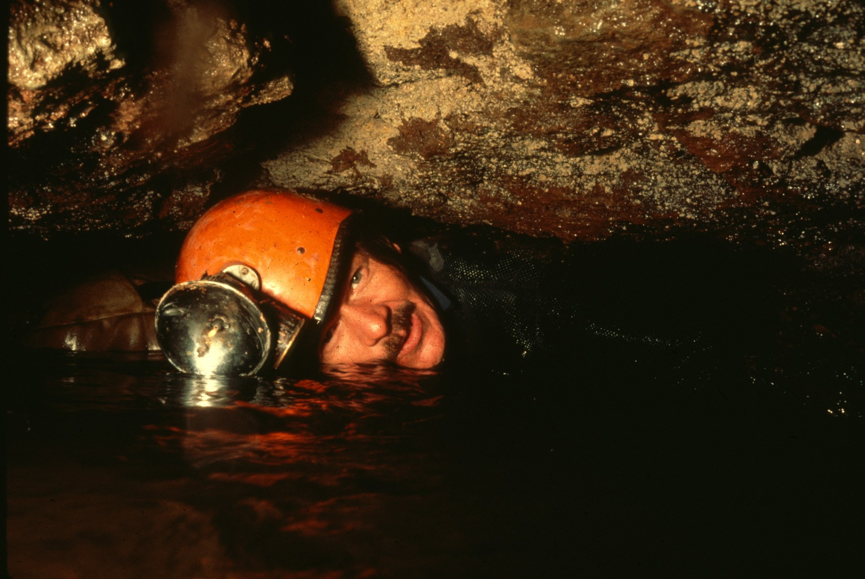
Notes:
Barry – Ron Simmons

Slide 51
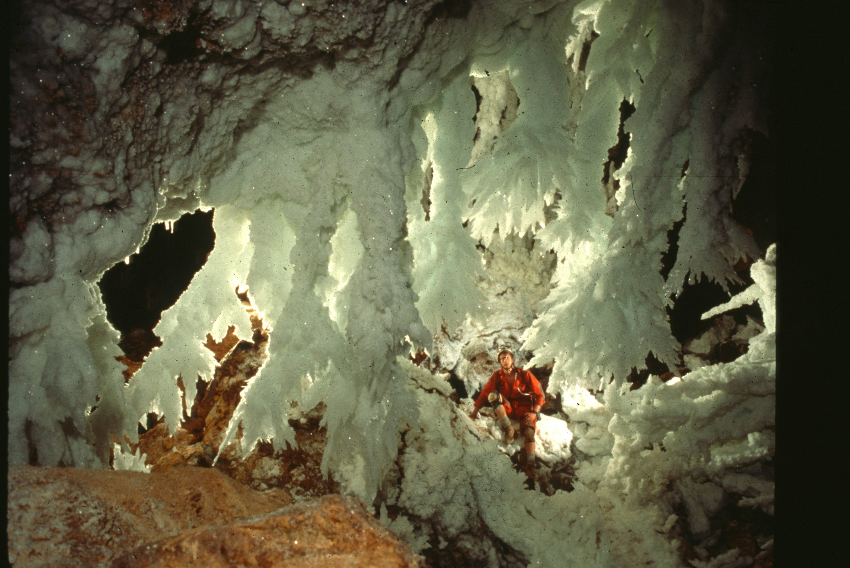
Notes:
Not From Here, You Haven’t – Bill Storage and Roland Vinyard

Slide 52
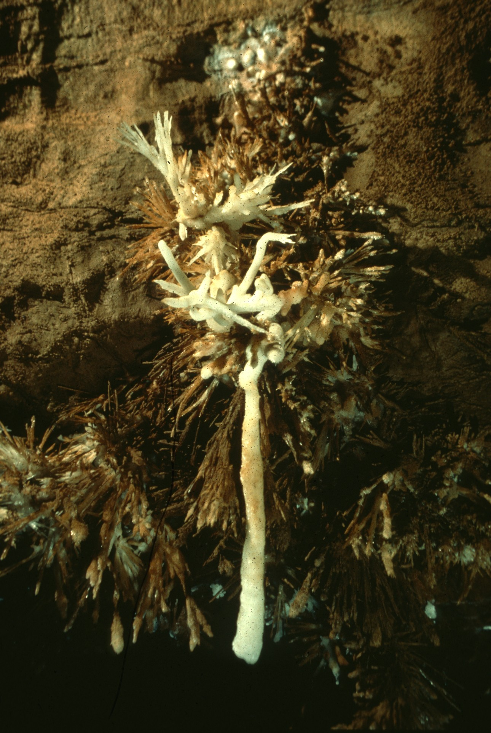
Notes:
The Elk Horn – Ron Simmons

Slide 53

Notes:
Etude in Pink – John Van Swearingen, IV and Kirsten Mullerlindemann

Slide 54

Notes:
Tower Place - Peter and Ann Bosted

Slide 55

Notes:
The Lasso – Rick Day

Slide 56

Notes:
Emerald Window – Dave Bunnell

Slide 57

Notes:
Two On Rope – Horton H. Hobbs, III

Slide 58

Notes:
X-Ray Gypsum Flowers – Norman Thompson

Slide 59

Notes:
Worth the Hike – Rick Day

Slide 60

Notes:
Alien Twins – Dave Bunnell

Slide 61

Notes:
Wet and Confusing Dreams – Dave Bunnell

Slide 62

MERIT AWARD
PHOTO SALON

Slide 63

Notes:
A Delicate Move – Peter and Ann Bosted

Slide 64

Notes:
U-Turn – Dave Bunnell

Slide 65

Notes:
Transparent Beauty – Norman Thompson

Slide 66

Notes:
Djuna Bewley and the Easter Bunny – Norman Thompson

Slide 67

Notes:
Epuran Lake – Carolyn Cronk and Cristian Lascu

Slide 68

Notes:
For Purple Sides – John Van Swearingen, IV

Slide 69
BEST OF SHOW
PHOTO SALON

Slide 70

Notes:
No Waves Please – Ron Simmons

Slide 71
Photographers

Slide 72
Photographers:
  Djuna Bewley
  Peter and Ann Bosted
  Dave Bunnell
  Carolyn Cronk
  Rick Day
  Scott Fee
  Charles Festerman
  Andy Grubbs
  Horton H. Hobbs, III
  Cristian Lascu

Slide 73
Photographers:
  Dick Laforge
  Bob Loney
  Jim Loftin
  Kirsten Mullerlindemann
  Gregg Oelker
  Norman Thompson
  John Scheltens
  Ron Simmons
  Bill Storage
  John Van Swearingen, IV
  Roland Vinyard

Slide 74

An NSS Audio-Visual Library Presentation
The Best of the
1990 NSS Photo Salon
Original slide program S912
Slides digitized by David Caudle
PowerPoint program created by Jim McConkey
74 slides, with script in presenter notes
PowerPoint created 2/22/2021
National Speleological Society
6001 Pulaski Pike
Huntsville, AL 35810-1122
256- 852-1300
nss@caves.org
https://caves.org/

